Slide 1
Understanding a decade of internal migration in Britain at the start of the 21st century – from spatial interaction to life course explanations
Adam Dennett
Centre for Advanced Spatial Analysis
University College London

Slide 2
Acknowledgements
ESRC Census Programme grant to the Centre for Interaction Data Estimation and Research, CIDER (RES-348-25-005)
John Stillwell and Oli Duke-Williams, University of Leeds

Slide 3
Outline
Background
Aims and data sources used
The main characteristics of internal migration in Britain between 1999 and 2008
Introduction to the internal ‘Migration Classification’ for local authority districts
Models of internal migration - the influence of spatial structure on internal migration in Britain
Life-course explanations for internal migration patterns in the context of the Migration Classification
Conclusions

Slide 4
Aims
To examine the main characteristics of internal migration in Britain between 1999 and 2008 using data from NHS patient registers
To introduce the CIDER Migration Classification as a vehicle for analysing patient register internal migration data in Britain
To examine the insights into internal migration patterns spatial interaction models can offer
To explore, where spatial structure explanations fall short, the effect of life course influences on internal migration in the context of Migration Classification area types

Slide 5
Data sources
Mid 1998-99 to Mid 2007-08 , GB, inter-district flow estimates derived mainly from NHS Patient Registers, disaggregated by 8 broad age groups.
Full 408x408 matrices estimated from several datasets using technique outlined by Dennett and Rees (2010) - 8% final data are estimates
Data set | Spatial scale and coverage | Time periods | Variables | Source
2001 Census Special Migration Statistics | District UK coverage | Mid 2000-01 | Total migrants and migrants by broad age group 8 variables | http://cider.census.ac.uk
Patient register migration data | District - England and Wales coverage | Annual data from mid 1998-99 – 2007-08. 10 datasets. | Total migrants and by broad age group | http://cider.census.ac.uk
Community Health Index migration data | District - Scotland coverage | Annual data from mid 2001-02 to 2006-07 – 7 datasets | Total migrants and by broad age group | http://www.gro-scotland.gov.uk/
NHSCR migration data rounded to nearest 100 | Government Office Region. UK coverage | Mid 1998-99 to 2007-08 – 10 datasets | Total migrants | http://statistics.gov.uk/
NHSCR-based in and out flows between Scotland and England and Wales and Northern Ireland unrounded | Government Office Region to country and vice versa | Mid 1998-1999 to mid 2007-08 | Total migrants | http://www.gro-scotland.gov.uk/

Slide 6
Inter-district internal migration in Britain by age group
Notes:
2001 comparable to census data – total inter-district migrants 2,450,226

Slide 7
Decline in migration propensity

Slide 8
Decline in migration propensity – 20-24 age group

Slide 9
Understanding sub-national patterns
But what is happening sub-nationally?
Within a system of 408x408 zones, the total number of possible flows to analyse = 166,464
A system for aggregating these spatial units into fewer groups is required, but which system is appropriate/most useful?
Larger administrative units – e.g. Regions?
Classification based on area characteristics?
General purpose classifications used successfully in internal migration analysis before (Raymer and Giulietti, 2009, Dennett and Stillwell, 2010)

Slide 10
CIDER Migration Classification
Classification of local authority districts based entirely on internal migration variables from 2001 Census
Areas classified by types of migrant (age, ethnicity, NS-SEC, family status, dwelling status) and their migration behaviour (in/out/with area)
Area profiles add richness to attribute poor patient register data
Dennett and Stillwell (2009)
Notes:
Cluster names indicative of types of migrant
Benefit of clusters not confounding migration patterns

Slide 11
Net migrants by cluster 1999-2008

Slide 12
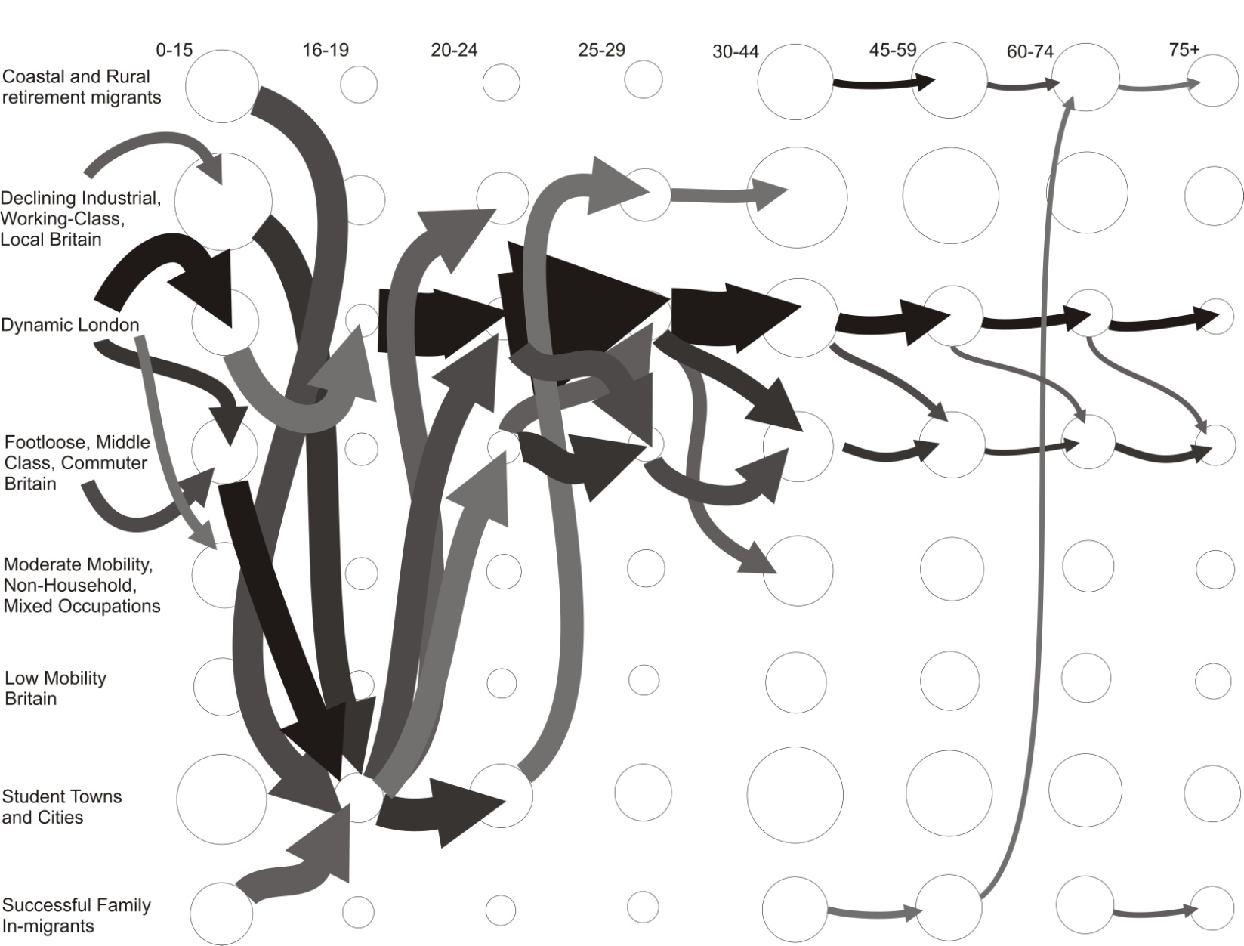
Top 5 gross flow rates between clusters at each age (average 1999-2008)
Notes:
Size circle proportional to total population/migrants at each age group in each cluster, arrows proportional to size of flow
Key point – dominance of London and footloose clusters – student towns at 16-19

Slide 13
Net migration rates (per 1,000 people) between clusters – 1999-2008 average
Origin | Destination | total | 0-15 | 16-19 | 20-24 | 25-29 | 30-44 | 45-59 | 60-74 | 75+
Dynamic London | Footloose, Middle-Class, Commuter Britain | 26.00 | 46.36 | -33.98 | -17.10 | 14.93 | 50.27 | 16.81 | 14.54 | 17.79
Dynamic London | Moderate Mobility, Non-Household, Mixed Occupations | 22.39 | 33.24 | -12.87 | 8.74 | 25.11 | 34.65 | 14.61 | 13.23 | 14.02
Footloose, Middle-Class, Commuter Britain | Successful Family In-migrants | 10.50 | 10.44 | -2.28 | 1.64 | 8.84 | 13.75 | 13.12 | 13.17 | 2.32
Footloose, Middle-Class, Commuter Britain | Coastal and Rural Retirement Migrants | 9.64 | 9.65 | 0.62 | -1.44 | 4.23 | 10.81 | 14.61 | 13.31 | 1.48
Moderate Mobility, Non-Household, Mixed Occupations | Coastal and Rural Retirement Migrants | 9.49 | 11.52 | 1.46 | -3.49 | 3.67 | 12.04 | 12.52 | 11.40 | 3.38
Moderate Mobility, Non-Household, Mixed Occupations | Successful Family In-migrants | 9.37 | 12.94 | -4.42 | -4.80 | 4.38 | 14.74 | 9.46 | 9.11 | 5.44
Dynamic London | Coastal and Rural Retirement Migrants | 8.10 | 12.69 | -17.81 | -12.89 | -1.71 | 12.36 | 11.60 | 13.39 | 6.95
Dynamic London | Low Mobility Britain | 7.63 | 12.99 | -8.57 | -0.58 | 3.54 | 11.90 | 6.21 | 6.88 | 6.46
Student Towns and Cities | Low Mobility Britain | 6.68 | 16.85 | -72.69 | 3.21 | 17.38 | 18.95 | 4.34 | 4.72 | 7.54
Dynamic London | Successful Family In-migrants | 6.57 | 13.16 | -27.36 | -14.54 | -4.55 | 12.98 | 8.72 | 10.05 | 6.61
Low Mobility Britain | Coastal and Rural Retirement Migrants | 5.83 | 5.90 | 3.87 | 2.71 | 4.80 | 6.73 | 7.40 | 6.20 | 1.63
Student Towns and Cities | Declining Industrial, Working-Class, Local Britain | 5.51 | 13.23 | -100.52 | 14.23 | 17.21 | 16.72 | 7.02 | 5.52 | 7.58
Low Mobility Britain | Successful Family In-migrants | 5.33 | 6.00 | -2.76 | 3.41 | 5.34 | 7.18 | 5.59 | 5.00 | 3.37
Student Towns and Cities | Successful Family In-migrants | 4.33 | 14.38 | -109.90 | 0.90 | 9.23 | 17.84 | 8.21 | 7.21 | 7.21
Declining Industrial, Working-Class, Local Britain | Successful Family In-migrants | 4.11 | 5.55 | -1.61 | 0.30 | 3.52 | 6.22 | 3.69 | 3.35 | 2.81
Declining Industrial, Working-Class, Local Britain | Coastal and Rural Retirement Migrants | 4.08 | 4.64 | 0.64 | 0.15 | 1.80 | 4.97 | 5.21 | 4.10 | 2.74
Moderate Mobility, Non-Household, Mixed Occupations | Footloose, Middle-Class, Commuter Britain | 3.58 | 7.98 | 0.33 | -9.16 | -3.71 | 8.40 | 1.75 | 1.22 | 3.03
Student Towns and Cities | Coastal and Rural Retirement Migrants | 3.14 | 12.64 | -110.35 | -6.72 | 6.67 | 14.94 | 9.50 | 9.32 | 6.15
Successful Family In-migrants | Coastal and Rural Retirement Migrants | 2.82 | 0.37 | 8.82 | 3.23 | 2.81 | 1.58 | 4.57 | 3.53 | 1.93
Student Towns and Cities | Dynamic London | 1.43 | -9.16 | -43.36 | 62.63 | 36.04 | -7.91 | -4.34 | -3.15 | -2.25
Footloose, Middle-Class, Commuter Britain | Low Mobility Britain | 1.18 | 0.48 | 2.60 | 1.89 | 4.95 | 0.97 | 1.17 | 1.61 | -0.77
Footloose, Middle-Class, Commuter Britain | Student Towns and Cities | 0.75 | -3.88 | 123.14 | -31.59 | -15.62 | -6.27 | -0.21 | -0.65 | -3.37
Student Towns and Cities | Moderate Mobility, Non-Household, Mixed Occupations | 0.68 | 3.11 | -79.32 | 28.14 | 13.24 | 4.43 | 0.08 | 0.54 | 2.13
Declining Industrial, Working-Class, Local Britain | Low Mobility Britain | 0.47 | 1.57 | -1.56 | -2.77 | -1.00 | 1.62 | -0.15 | -0.01 | 1.62
Dynamic London | Declining Industrial, Working-Class, Local Britain | 0.41 | 3.38 | -7.64 | -10.76 | -5.05 | 3.02 | 1.51 | 1.39 | 0.69
Moderate Mobility, Non-Household, Mixed Occupations | Declining Industrial, Working-Class, Local Britain | 0.31 | 1.13 | 0.15 | -4.38 | -1.85 | 1.02 | 0.97 | 0.56 | -0.63
Moderate Mobility, Non-Household, Mixed Occupations | Low Mobility Britain | 0.20 | 3.41 | -1.07 | -7.74 | -4.68 | 1.45 | -0.52 | 0.14 | 0.44
Footloose, Middle-Class, Commuter Britain | Declining Industrial, Working-Class, Local Britain | 0.06 | 0.56 | -0.28 | -4.06 | -1.07 | 0.58 | 0.71 | 0.50 | -0.97
*Ranked by total

Slide 14
Standardising for the effect of age – standardised migration ratios (SMIRs)
Excluding intra-cluster flows
Notes:
Low mobility Britain classified as low mobility due to age structure of migrants (few young in and outs) and preponderance of moves within clusters

Slide 15
Standardising for the effect of age – standardised migration ratios (SMIRs)
Including intra-cluster flows
Notes:
Most variation in in-migration ratio – where above average, moving towards national average as head towards 2008
Make the point that declining industrial cluster features very little in internal migration story of UK

Slide 16
Explaining internal migration - the influence of spatial structure
Fitting doubly constrained spatial interaction models to flow data within the MC framework highlights influences acting on flows between clusters…
Standard model
Origin specific model
Destination specific model
O/D specific models allow for an assessment of varying distance decay for in- and out-migration
$$M_{ij}= A_{i}B_{j}O_{i}D_{j}f(d_{ij})$$
$$M_{Ij}= A_{I}B_{j}O_{I}D_{j}f(d_{Ij})$$
$$M_{iJ}= A_{i}B_{J}O_{i}D_{J}f(d_{iJ})$$
D_{ij} = Distance between Origin i and Destination j (cost of travel)
A_{i} / B_{j} = Balancing factors to ensure Mij estimates conform to known O_{i} / D_{j} totals
M_{ij} = Migration between Origin i and Destination j
f = a function applied to the distance to represent the increasing decay of flows as distance increases (usually –exp or inv power) – often a β parameter estimated within the model…
O_{i} / D_{j} = Known information about the total in and out-migration for each zone in the system

Slide 17
How well do doubly constrained models fit the data?
Coefficient of determination (R²) values show consistently good fits across all age groups and years
Model based on total inflows, outflows and average distance between all districts within each cluster accounts for between 82% and 96% of variation in migration flows between clusters within the system
 | 1999 | 2000 | 2001 | 2002 | 2003 | 2004 | 2005 | 2006 | 2007 | 2008
Total Flows | 0.911 | 0.901 | 0.904 | 0.903 | 0.905 | 0.903 | 0.907 | 0.905 | 0.897 | 0.903
0-15 | 0.897 | 0.888 | 0.892 | 0.887 | 0.887 | 0.882 | 0.880 | 0.879 | 0.873 | 0.876
16-19 | 0.965 | 0.964 | 0.962 | 0.963 | 0.959 | 0.956 | 0.955 | 0.955 | 0.947 | 0.946
20-24 | 0.908 | 0.907 | 0.903 | 0.905 | 0.901 | 0.897 | 0.892 | 0.892 | 0.886 | 0.884
25-29 | 0.948 | 0.943 | 0.951 | 0.951 | 0.953 | 0.955 | 0.954 | 0.949 | 0.948 | 0.951
30-44 | 0.942 | 0.932 | 0.932 | 0.931 | 0.932 | 0.931 | 0.937 | 0.939 | 0.937 | 0.944
45-59 | 0.895 | 0.889 | 0.886 | 0.895 | 0.886 | 0.884 | 0.885 | 0.877 | 0.875 | 0.873
60-74 | 0.907 | 0.911 | 0.910 | 0.916 | 0.912 | 0.911 | 0.900 | 0.910 | 0.903 | 0.897
75+ | 0.841 | 0.839 | 0.843 | 0.842 | 0.838 | 0.828 | 0.835 | 0.821 | 0.828 | 0.829

Slide 18
Interpreting the model - the frictional effect of distance
Origin / Destination β distance decay parameters 1998/99
In-migration
Out-migration
Notes:
This is for 1998/99 – very little difference in patterns in other years
Distance has lowest frictional effect for those in 16-19, 20-24 age groups
Frictional effect distance least for coastal and rural – positive for 20-24 out-migration (further away the better!)
Frictional effect highest for districts in ‘low mobility britain’ – even higher for in-migration to Djs

Slide 19
Interpreting the model - the frictional effect of distance
Predicted mean migration distances, 1998/99
Notes:
London: very much defined by short out-migration distances – in-migration
Student towns and cities – short in-migration moves at older ages, although lengthened at age when students attend university

Slide 20
Model shortcomings – residuals 1998/99 (indicative all years)
Gross residuals (origin specific β) | Coastal and Rural Retirement Migrants | Declining Industrial, Working-Class, Local Britain | Dynamic London | Footloose, Middle-Class, Commuter Britain | Moderate Mobility, Non-Household, Mixed Occupations | Low Mobility Britain | Student Towns and Cities | Successful Family In-migrants
Coastal and Rural Retirement Migrants | 11429 | -3412 | -6221 | -4027 | -578 | -9683 | 1717 | 10427
Declining Industrial, Working-Class, Local Britain | -681 | 5012 | 3754 | -850 | -9 | -6092 | 3785 | -6000
Dynamic London | -3308 | 4623 | 27183 | -20780 | -11599 | 3766 | 14758 | -12620
Footloose, Middle-Class, Commuter Britain | -5329 | -2324 | -18849 | 18573 | 744 | 2920 | 4630 | 144
Moderate Mobility, Non-Household, Mixed Occ | -1783 | -3594 | -10957 | 6143 | 2131 | 4716 | -1 | 3507
Low Mobility Britain | 936 | -4410 | -4174 | 372 | 4821 | -396 | 7752 | -5110
Student Towns and Cities | -8674 | 11771 | 19630 | 3288 | 3058 | 11533 | -36515 | -4955
Successful Family In-migrants | 7409 | -7666 | -10366 | -2720 | 1432 | -6764 | 3874 | 14606
Standardised residuals (origin specific β)
Coastal and Rural Retirement Migrants | 122.2 | 91.4 | 70.8 | 84.8 | 58.5 | 97.3 | 102.7 | 129.0
Declining Industrial, Working-Class, Local Britain | 98.5 | 104.5 | 137.8 | 94.8 | 82.1 | 99.9 | 103.9 | 83.9
Dynamic London | 87.7 | 166.9 | 113.5 | 77.9 | 130.1 | 81.1 | 151.9 | 60.5
Footloose, Middle-Class, Commuter Britain | 86.0 | 85.6 | 72.4 | 131.1 | 116.8 | 101.9 | 110.3 | 100.4
Moderate Mobility, Non-Household, Mixed Occ | 94.5 | 79.8 | 72.4 | 117.2 | 128.2 | 107.3 | 100.0 | 111.8
Low Mobility Britain | 105.0 | 85.5 | 71.8 | 102.1 | 97.8 | 127.5 | 118.4 | 78.0
Student Towns and Cities | 88.9 | 112.3 | 158.1 | 107.1 | 124.7 | 107.7 | 72.4 | 92.8
Successful Family In-migrants | 118.3 | 75.3 | 56.0 | 90.3 | 66.6 | 106.3 | 107.1 | 143.0
Standardised = (obs/pred)*100
Green = Observed flows higher than model prediction – model under predicts
Red = Observed flows lower than model prediction – model over predicts

Slide 21
Residual interpretation
Model significantly under-predicts flows between Dynamic London and Student Towns, and over-predicts flows within Student Towns - Why?
Highest volume of in-migration flows occurs 20-24 age group – post university. Model doesn’t account for huge pull of socio-economic ‘gravity’ from the Capital for this age group (compared to other destinations in GB)
Flows in other direction (some 6,500 people p.a) of 16-19 year olds are under-accounted for by model – model doesn’t account for significant higher education life course influence pulling students out of the Captial
Over-prediction of flows within student towns and cities partially caused by balancing effect of other under-predicted flows in the closed model system

Slide 22
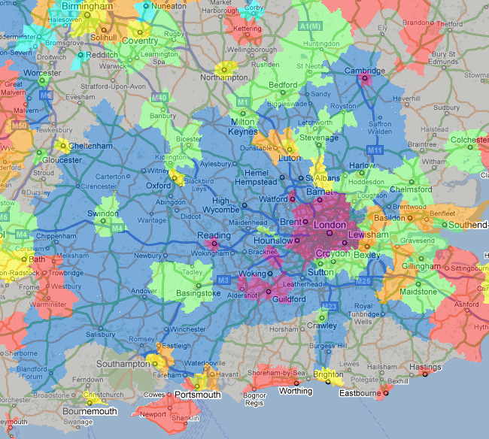
Residual interpretation
Model significantly over-predicts flows between Dynamic London and Footloose, Middle Class Commuter Britain, and under-predicts flows within Footloose, Middle Class Commuter Britain - Why?
Likely cause partially associated with the under-prediction of flows within the Footloose cluster (3rd highest at 30-44):
With many migrants tethered to the cluster through employment in the Capital, moves unlikely to be related to change in status (student to employed or employed to retired) – more likely residential improvement (increase in family size?)
Therefore, distance unlikely to depress within cluster moves, leading to large model under-prediction
Notes:
Footloose cluster characterised by in-migration of migrants from London in mid to late 20s in higher socio-economic groups, but model still over predicts…

Slide 23
Additional life course interpretations
Age groups 0-15 & 30-44:
High rates of out-migration from Dynamic London Cluster to Middle Class Commuter cluster = down urban hierarchy move (Plane et al. 2005)?
Yes, but high frictional effects of distance and low flow distances reflect the strong economic pull of capital fighting pull of improved ‘family rearing’ opportunities outside the Capital – thus limiting distance travelled
Strong interaction between two clusters important in internal migration profile of Britain – not just down the urban hierarchy in an unselective way
Notes:
Perception better schools, safer… etc.

Slide 24
Additional life course interpretations
Age group 16-19
Pull to Student Towns and Cities cluster considerable
As well as reflecting attraction of higher education, also reflects move up the urban hierarchy for non-students
Model residuals point to observed flow from footloose commuter cluster to student towns and cities being much higher than would be expected, perhaps reflecting the particular aspirations of the offspring of those in the well-off commuter belt…

Slide 25
Life course interpretations
Age group 20-24
Considerable exodus from Student Towns and Cities cluster – fuelled by search for post-higher education employment
Dynamic London cluster consistently most important destination (net terms)
Also the age at which largest decline in migration propensity occurs – why?
Possible link to house price increases although correlation not necessarily causation (with only 10 years of data, hard to make robust linkage)

Slide 26
Life course interpretations
Age groups 45-59 and 60-74
Continued evidence of migration moves down the urban hierarchy, although again a selective move down…
Net migration gains to Successful Family In-migrants and Coastal and Rural Retirement Migrants clusters from other clusters account for 8 of top 10 flows in 45-59 age group – fitting with pre-retirement transition (Bures, 1997, Plane and Jurjevich, 2009)
At 60-74 reduction in distance decay β parameter after increasing friction since 20-24 indicates that at age of retirement, distance much less of barrier to migration moves

Slide 27
Conclusions
Pattern of internal migration very stable in between 1999-2008
London, consistently highest rates of internal migration but net loser of migrants over 10 year period. Rates well above average when effects of distance and age accounted for.
High migration exchanges between London and Footloose Commuter cluster.
Declining industrial, working class cluster consistently low rates over 10 year period, even when controlling for age profile.
Student Towns and Cities high rates of migration can be attributed almost entirely to the huge influx of young student migrants and exodus of graduates.
National flows dominated by 20-24 age group but decline in overall migration propensity of this group for most clusters – possible correlation with house price fluctuations

Slide 28
Conclusions
Spatial interaction models have shown the large influence of spatial structure on flows within the system
Many of the flows between clusters the inevitable consequence of ‘social gravity’ – origin and destination migrant masses and the average distance between districts within clusters - the pattern is stable over time
Model residuals point to non-spatial system influences acting most heavily on flows within and between Dynamic London, Student Towns and Cities and Footloose, Middle Class, Commuter Britain
Different clusters appear to have particular life-course associations which can offer some explanations for migration patterns between 1999 and 2008 where spatial interaction models cannot account for the whole story

Slide 29
References
Bures, R. M. (1997), 'Migration and the life course: is there a retirement transition?', Int J Popul Geogr, 3 (2), 109-19.
Dennett, A. and Stillwell, J. (2009), ' A new migration classification for local authority districts in Britain', Working Paper 09/2, School of Geography, University of Leeds, Leeds.
Dennett, A. and Rees, P. (2010), 'Estimates of internal migration flows for the UK, 2000-2007', Population Trends, 140 (1), 82-105.
Dennett, A. and Stillwell, J. (2010), 'Internal migration in Britain, 2000–01, examined through an area classification framework', Population, Space and Place, 16 (6), 517-38.
Plane, D.A., Henrie, C.J., and Perry, M.J. (2005), 'Migration up and down the urban hierarchy and across the life course', PNAS, 102 (43), 15313-18.
Plane, D.A. and Jurjevich, J.R. (2009), 'Ties That No Longer Bind? The Patterns and Repercussions of Age-Articulated Migration', The Professional Geographer, 61 (1), 4 - 20.
Raymer, J. and Giulietti, C. (2009), 'Ethnic migration between area groups in England and Wales', Area, 41 (4), 435-51.

Slide 30
Thank you
Adam Dennett
a.dennett@ucl.ac.uk
http://adamdennett.co.uk

