Slide 1




Interaction Data: Progress and Potential
John Stillwell and Oliver Duke-Williams
Centre for Interaction Data Estimation and Research (CIDER)
School of Geography, University of Leeds
Presentation at
‘Census 2011: Impact and Potential’
University of Manchester, 7-8 July, 2011

Slide 2

Acknowledgement: Support from ESRC and data providers

Slide 3
Presentation
What has CIDER achieved over the last 5 years?
How have the interaction data sets been used in research?
What potential does the 2011 Census provide for data provision and research?
Conclusions: How will CIDER develop in the future?

Slide 4
1. What has CIDER achieved over the last 5 years?
1.1 Assembly and storage of large volume of origin-destination data sets
1.2 Development of important online interface (WICID) to the Census interaction data sets
1.3 Provision of training and advice to users
1.4 Research using the interaction data sets- examples

Slide 5
1.1 Assembly and storage of large volume of origin-destination data sets
CIDER’s audit of interaction data from various sources
Censuses of Population – comprehensive, reliable migration and commuting data, particularly for flows within and between small areas
Administrative records – collection of records arising from some transaction, registration or record of service delivery
Social surveys – population samples allowing useful cross-classification at national (regional) level
See Dennett, A., Duke-Williams, O. and Stillwell, J. (2007) Interaction data sets in the UK: An audit, Working Paper 07/05, School of Geography, University of Leeds (http://www.geog.leeds.ac.uk/research/wpapers)

Slide 6
CIDER’s interaction data sets
Census Origin-Destination Statistics
1981 SMS Set 2 and SWS Set C (county/region level)
1991 SMS Sets 1 and 2; SWS Sets A-C (ward level) and Table 100 (students flows at district level)
2001 SMS Sets 1 and 2; SWS (levels 1-3: districts, wards, output areas in England & Wales) STS (levels 1-3 and postal sectors in Scotland)
Some very large matrices
Country | Level 1 | Level 2 | Level 3
England | London Boroughs (33), Metropolitan Districts (36), Unitary Authorities (46), Other Local Authorities (239) | CAS wards (7,969) | Output areas (165,665)
Wales | Unitary Authorities (22) | CAS wards ( 881) | Output areas (9,769)
Scotland | Council Areas (32) | ST wards ( 1,176) | Output areas (42,604)
Northern Ireland | Parliamentary Constituencies (18) | CAS wards (582 ) | Output areas (5,022)
Total | Districts (426) | Interaction wards (10,608) | Output areas (223,060)

Slide 7
CIDER’s interaction data sets
Census Commissioned Tables
Set of tables from 2001 Census including, e.g.
C0648: Migrants by religion at district level
C0649: Commuters by religion at district level
C0711: Migrants by ethnic group and age at district level (including all-age immigrants from different world regions of previous residence)
C0723: Migrants by age and ethnic group at region/ward level
C0311: Commuters to OAs in London from districts in England and Wales

Slide 8
CIDER’s interaction data sets
Derived or estimated flows from Census data
SMSGAPS: Counts for 1991 SMS Set 2 Tables 3-10 derived by Rees and Duke Williams that include estimates of suppressed values
MIGPOP: Counts for 1991 SMS Set 2 Table 3 derived by Simpson and Middleton that adjust for under-enumeration
1981 SMS Set 2 (wards) and SWS Set C (wards): re-estimated for 1991 and 2001 geography by Boyle and Feng
1991 SMS Set 1 (wards) and SWS Set C (wards): re-estimated for 2001 geography by Boyle and Feng

Slide 9
CIDER’s interaction data sets
Estimated flows based on administrative data
Patient register/NHSCR flows between local authority districts in England and Wales, 19998/99-2007/08 (rounded) – estimated and supplied by ONS
Inter-NUTS2 region migration estimates for UK, 1999/2000 to 2006/2007 – estimated and supplied by Rees and Dennett (DEMIFER project)
Inter-NUTS2 region migration estimates for UK, calendar year 2000 to 2007 – estimated and supplied by Rees and Dennett (DEMIFER project)
Inter-region migration by age, sex and ethnicity for Britain, 1991-1999 and 2000-2007 estimated and supplied by Raymer and Giuletti (ESRC project)
Inter-county migration by age, sex and ethnicity, 1999-2007, estimated and supplied by Raymer and Giuletti (ESRC project)
Inter-county migration by age, sex and economic activity , 1999-2007, estimated and supplied by Raymer and Giuletti (ESRC project)

Slide 10
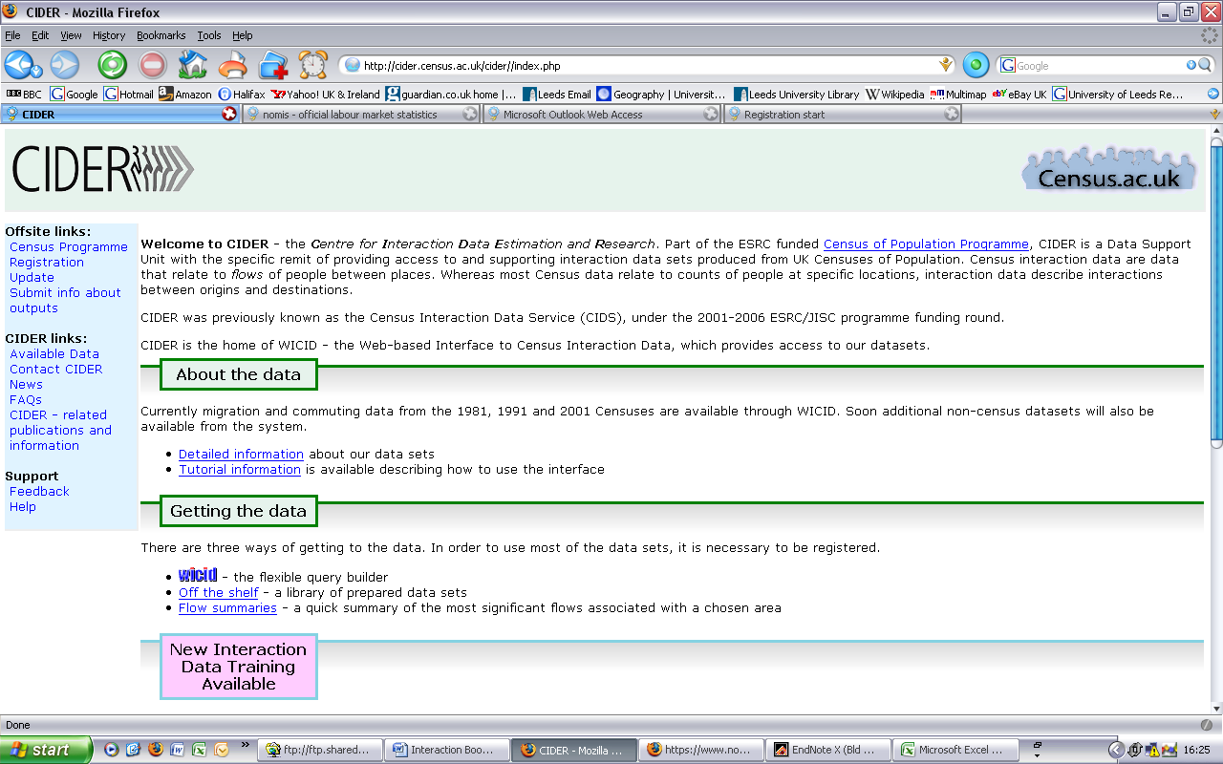
1.2 Development of important online interface to the Census interaction data sets
CIDER Home Page
Need to be a registered user of census data

Slide 11
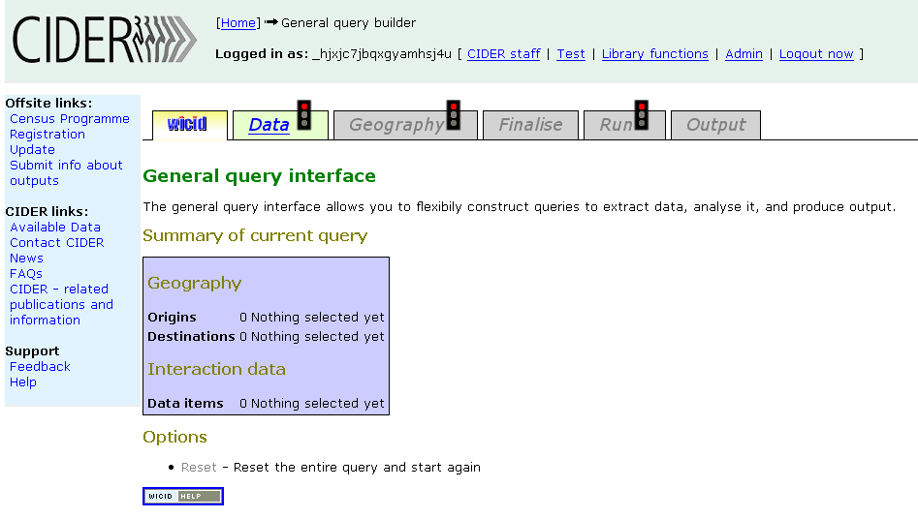
WICID Query Interface

Slide 12
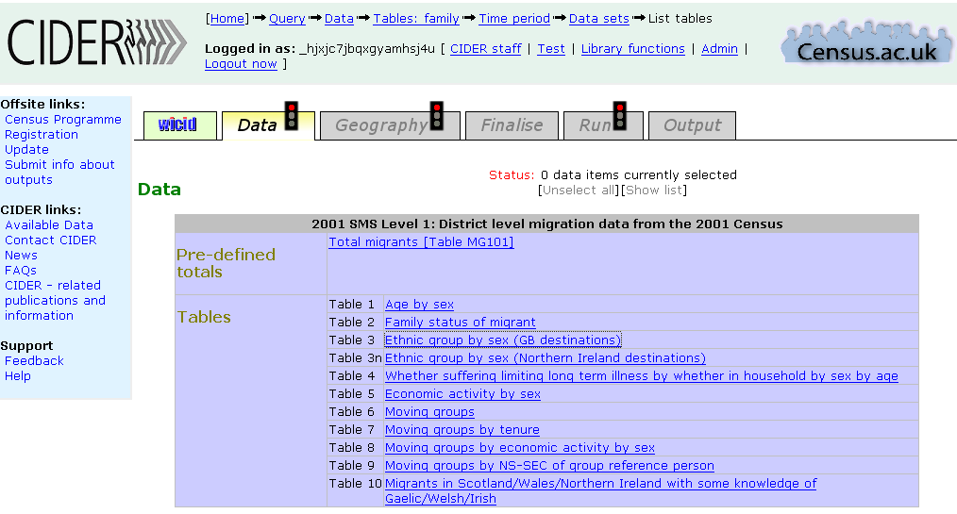
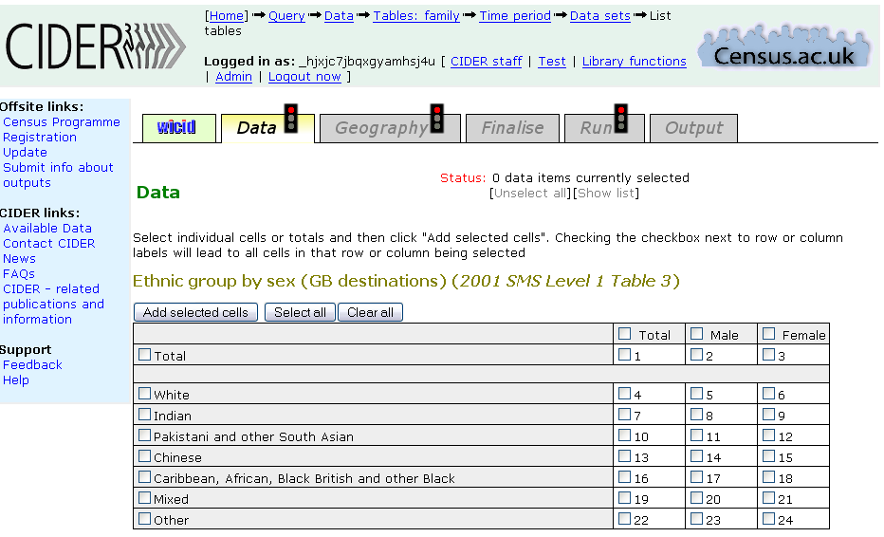
Data selection
Tables available in 2001 SMS Level 1
Cells of Table 3 in 2001 SMS Level 1

Slide 13
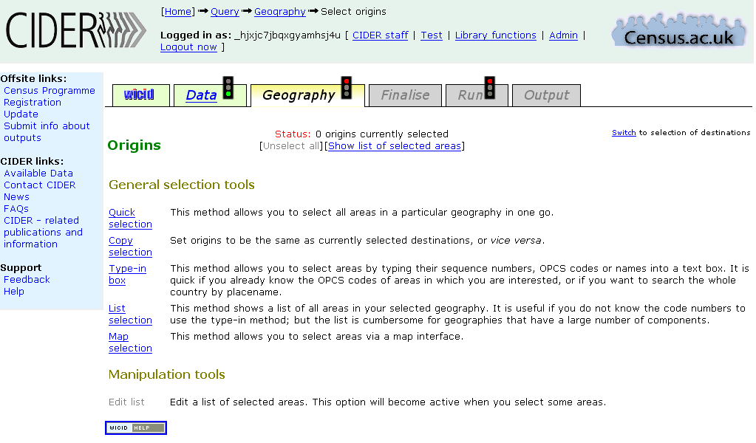
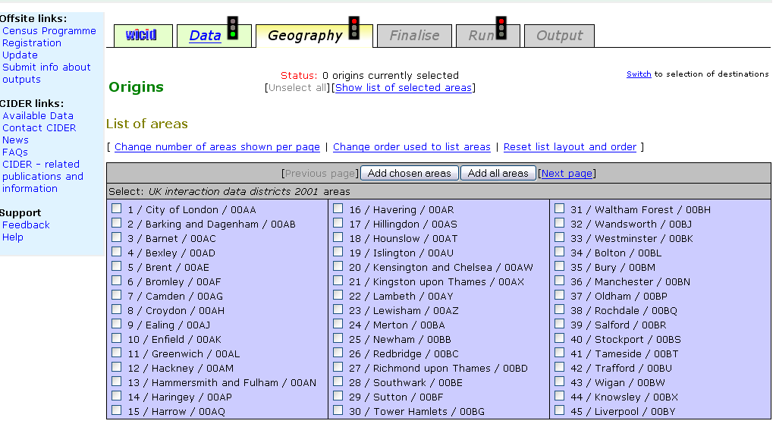
Geography selection
Area selection tools available
List selection of districts

Slide 14
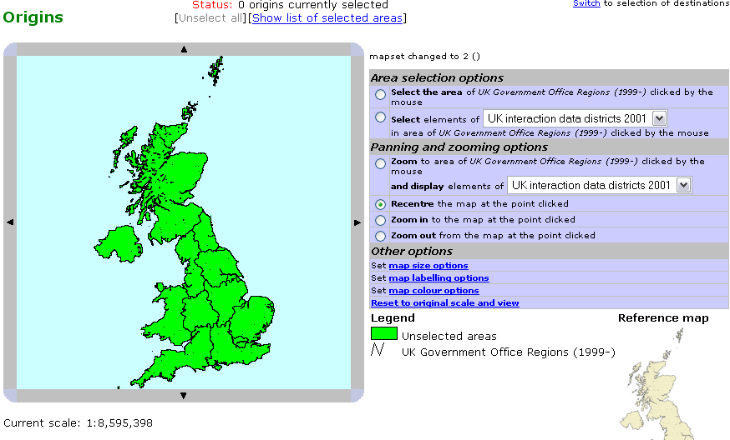
Map Selection Tool

Slide 15
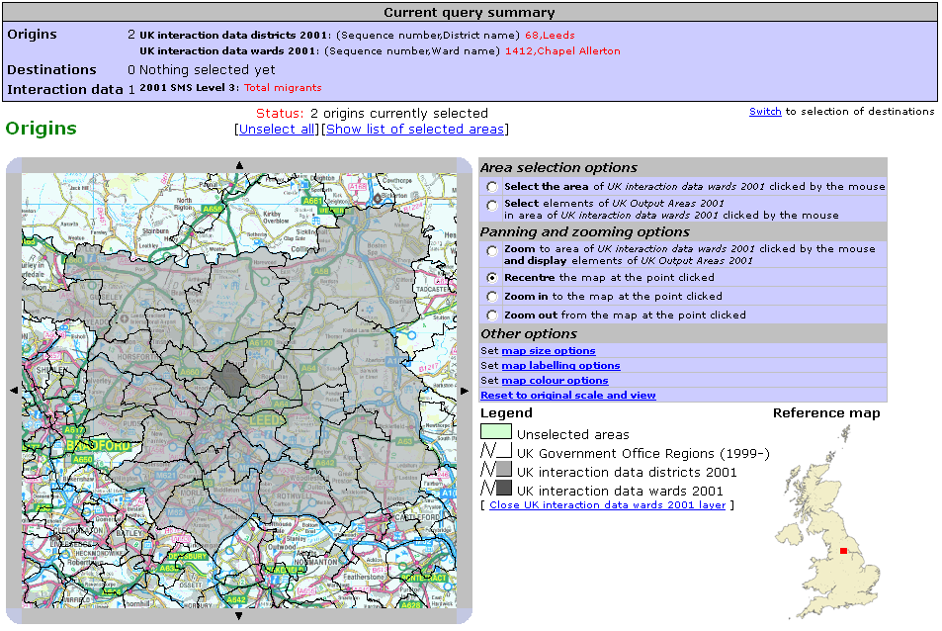
Map Selection Tool (detail)

Slide 16
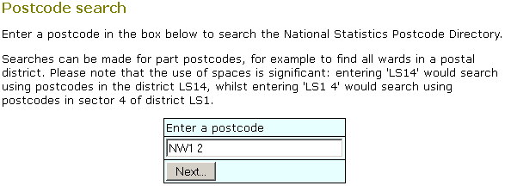
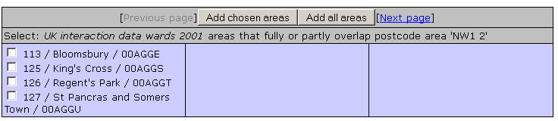
Postcode based selection

Slide 17
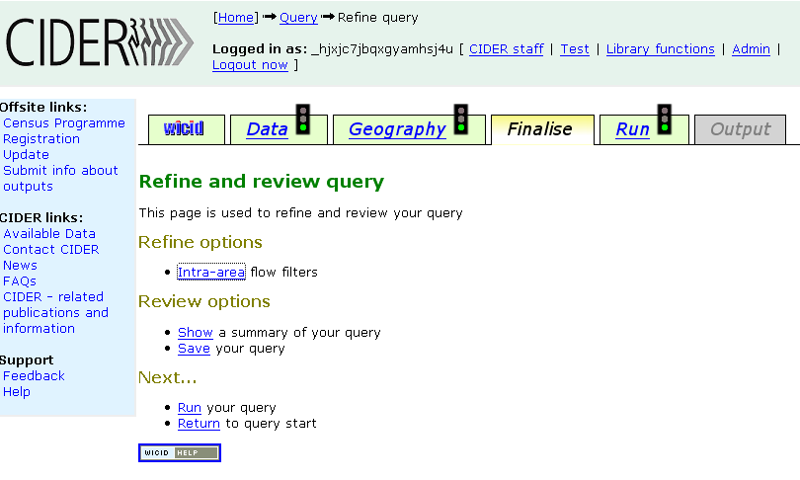
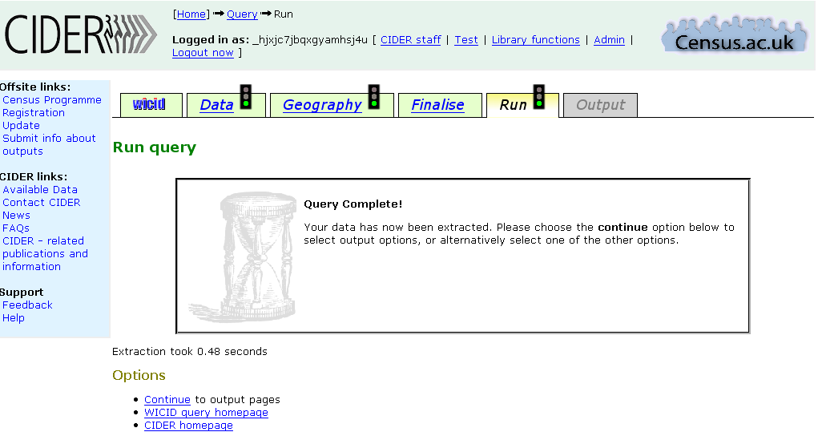
Finalise Screen
Screen Indicating Extraction Completed

Slide 18
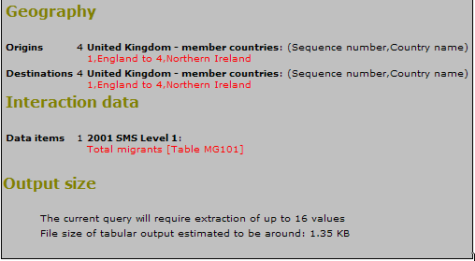
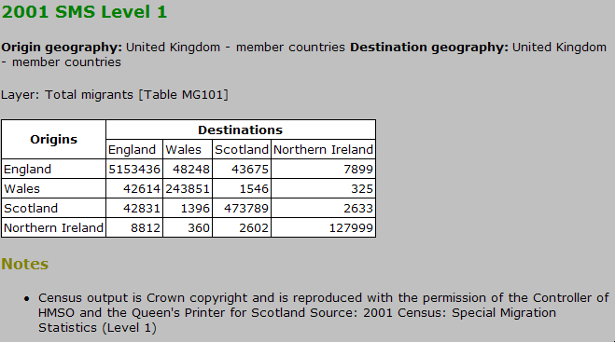
Example of simple query and data extracted
The Query: Extract the data on total migrant flows between the countries of the UK from Table MG1010 in 2001 SMS
The Data: Origin by destination matrix of migration flows in 2000-01

Slide 19
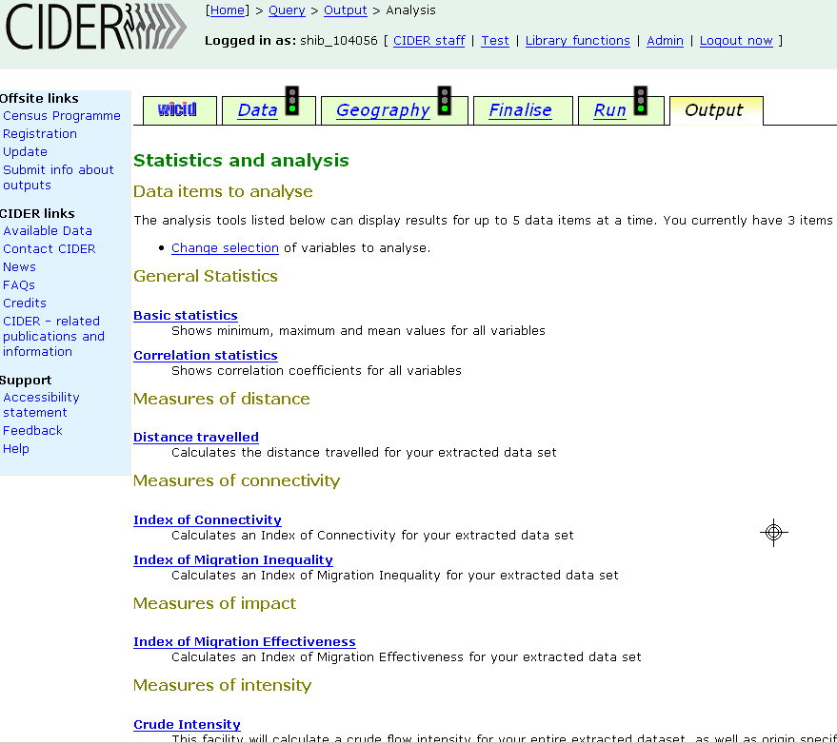
Analysis functions for use on extracted data

Slide 20
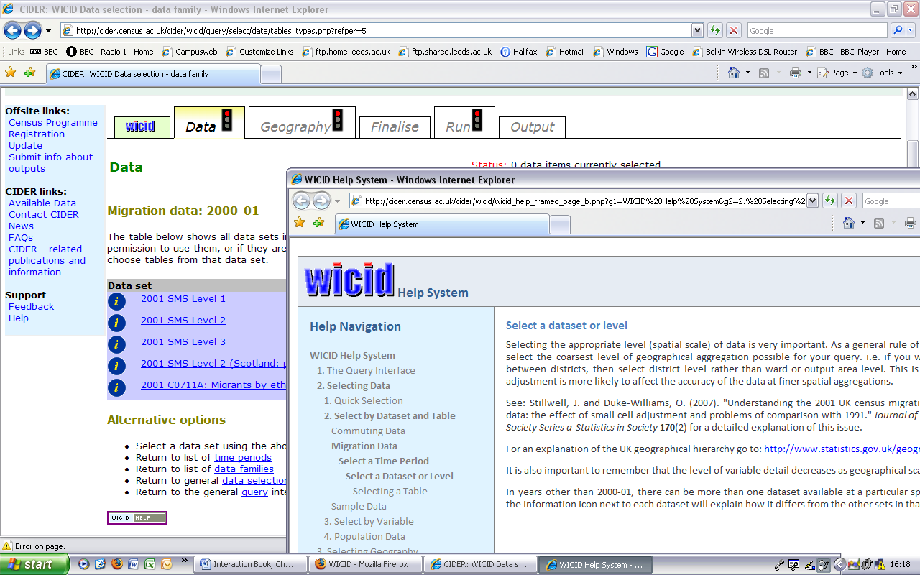
Help System opening inside a new browser window

Slide 21
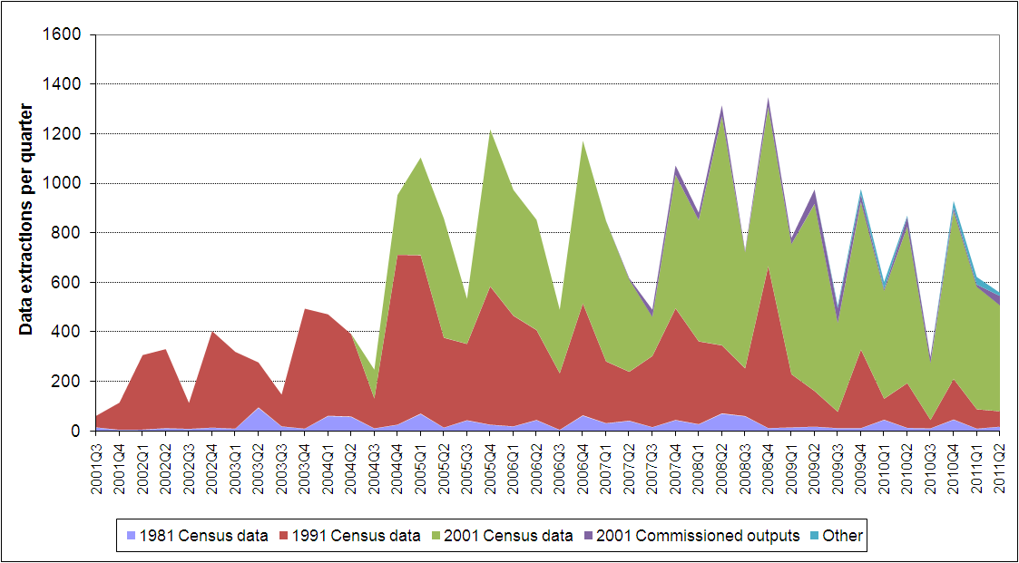
WICID User Statistics: Data extractions

Slide 22
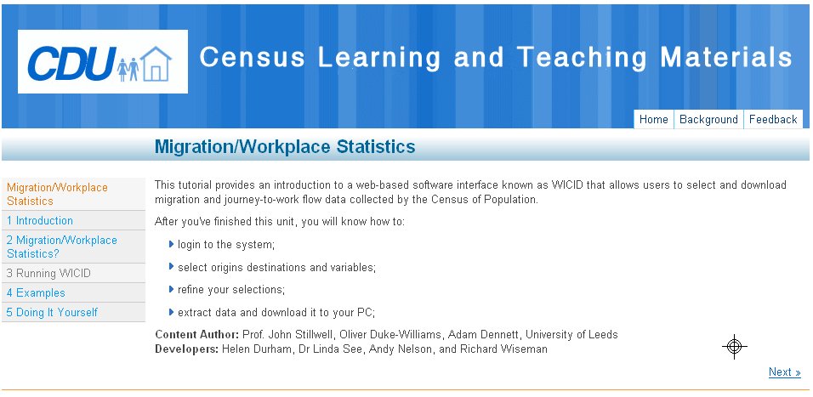
1.3 Provision of training and advice to users
Census Programme training workshops
Classroom exercises (Stillwell, 2006b; Dennett, 2010)
Bespoke support for research users – particularly those requiring large sets of data
Tutorial materials (CHCC project):

Slide 23

2. How have the interaction data sets been used in research?
2.1 Interaction data sets used by various researchers
See some examples in Part 2 of CIDER book:
CIDER staff plus Boden, Boyle, Champion, Coombes, Feng, Flowerdew, Frost, Giulietti, Harland, Norman, Raymer and Rees

Slide 24
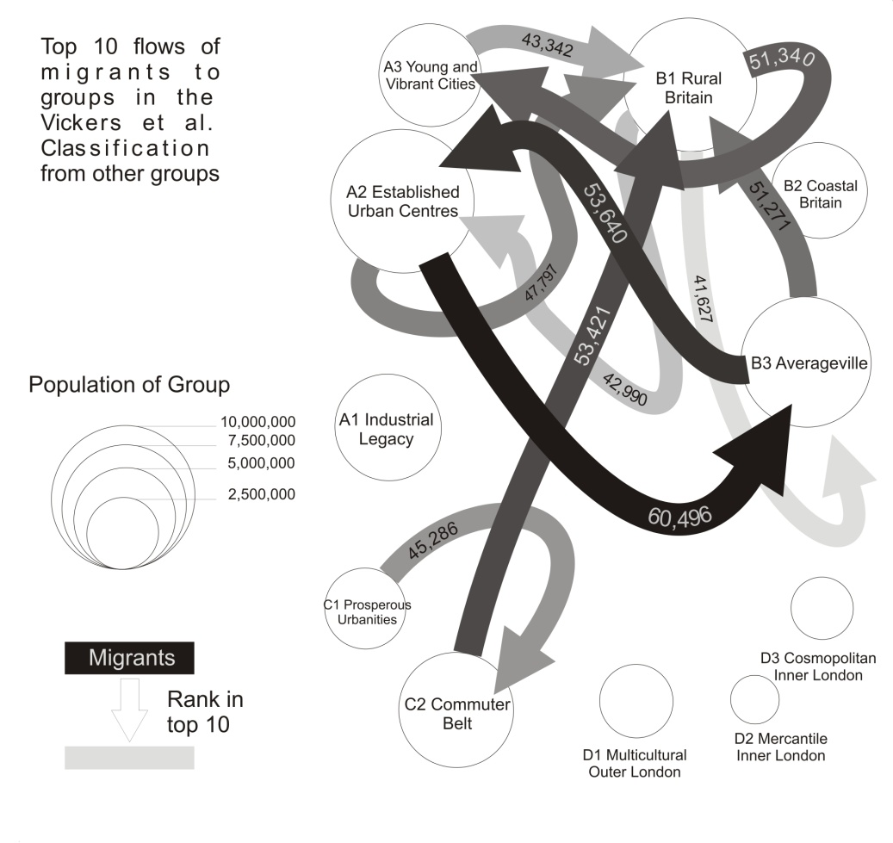
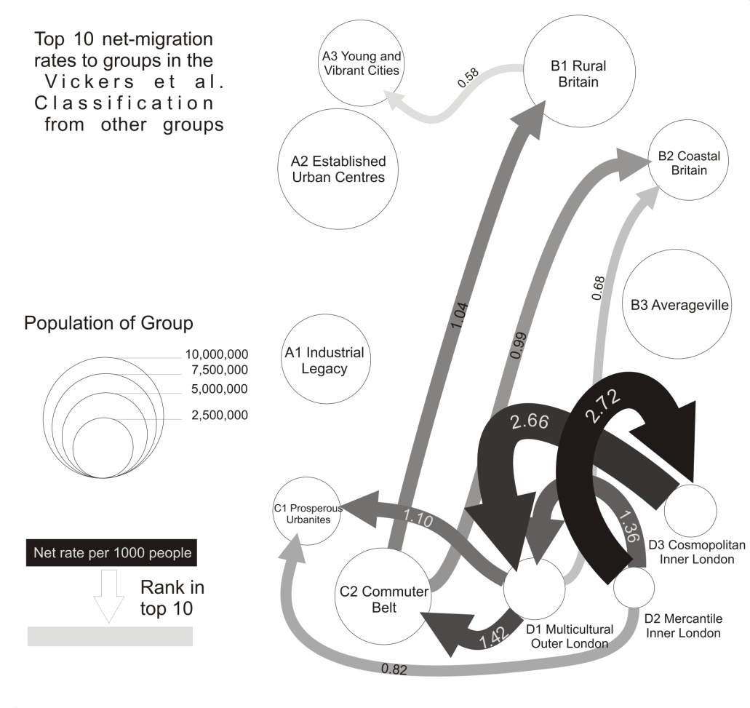
2.2 CIDER Research
Example 1: Migration patterns based on Vickers et al. (2003) district classification
.
Top ten directional flows and net migration rates between area clusters, 2000-01
Directional migration flows Directional net migration rates
Source: Dennett, A. and Stillwell, J. (2010) Internal migration in Britain, 2000-01, examined through an area classification framework, Population, Space and Place, 16(6): 517-538.

Slide 25
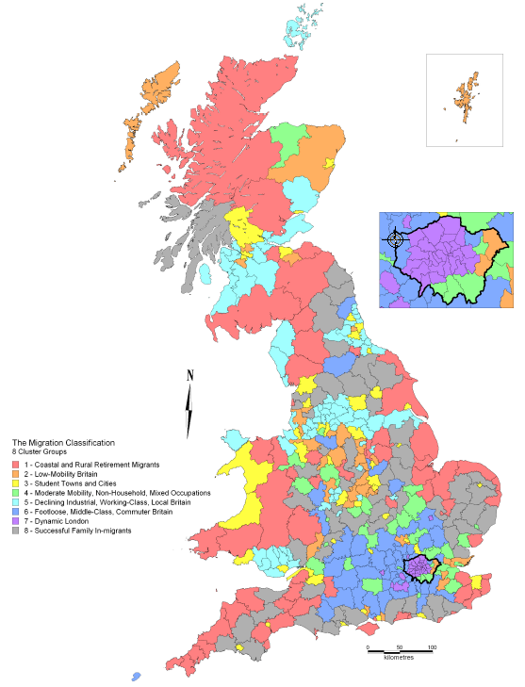
Example 2:
CIDER’s own migration-based district classification
District classification
408 districts used
56 migration variables selected
and standardised
Euclidian distance used as measure
of proximity
k-means algorithm used for clustering
Optimal solution is 8 clusters
Source: Dennett, A. (2010) Understanding internal migration in Britain at the start of the 21st century, PhD Thesis, School of Geography, University of Leeds.
Forthcoming papers in Population Trends and Journal of Population Geography

Slide 26
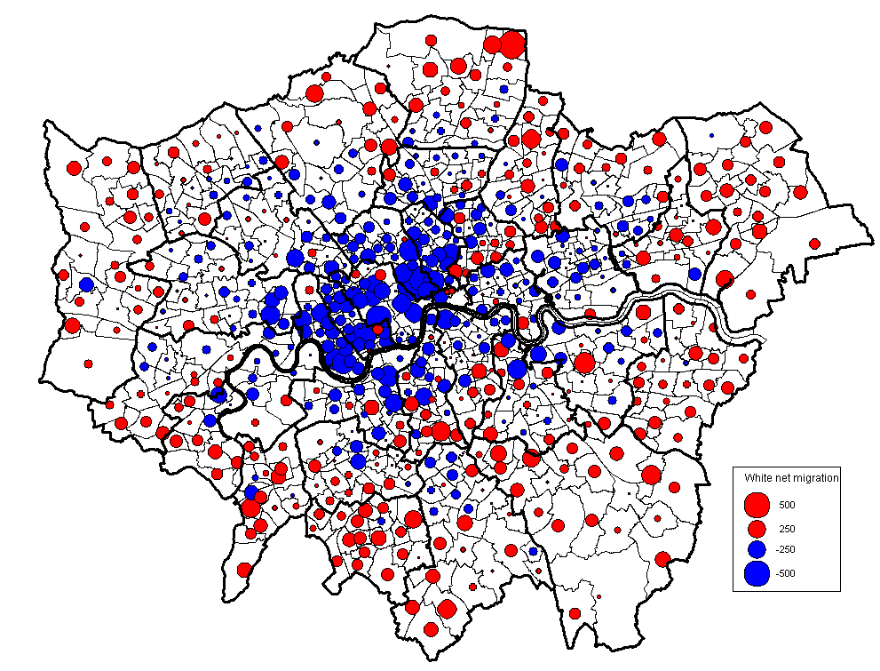
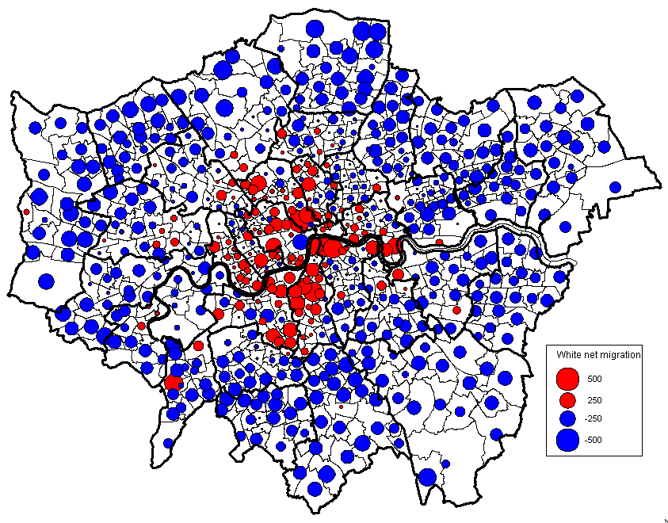
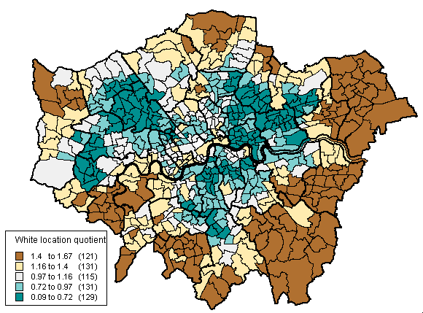
Example 3:
What processes of ethnic migration are taking place in London at ward level?
Net migration flows within Net migration flows between Greater London London and rest of England and Wales
WHITES
Source: 2001 Census Commissioned Table
Stillwell, J. (2010) Ethnic population concentration and net migration in London, Environment and Planning A, 42: 1439-1456.
Location quotients

Slide 27
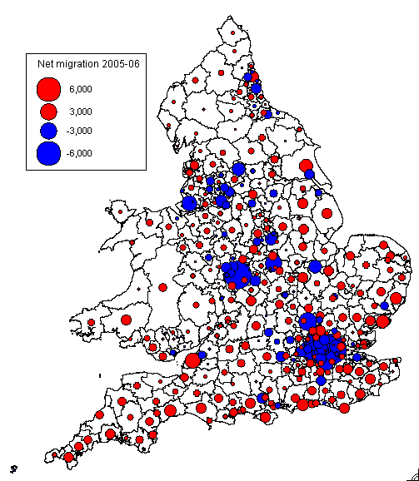
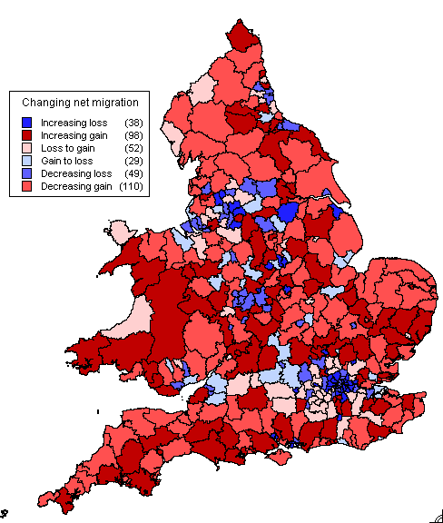
Example 4: Changing patterns of net migration as shown by patient register/NHSCR data
2005/06 net balances
Changes in net balances
2000/01-2005/06
Annual inter-district flows, 1998/99-2005/06
Source: Duke-Williams, O. and Stillwell, J. (2010) Temporal and spatial consistency, Chapter 5 in Stillwell, J., Duke-Williams, O. and Dennett, A. (eds.) (2010) Technologies for Migration and Commuting Analysis, IGI Global, pp. 89-110.

Slide 28
3. What potential does the 2011 Census provide for data provision and research?
3.1 What has not changed since 2001 in terms of available data based on questions asked?
3.2 What about statistical disclosure control?
3.3 What new questions enable further ‘interaction’ data to be generated?

Slide 29
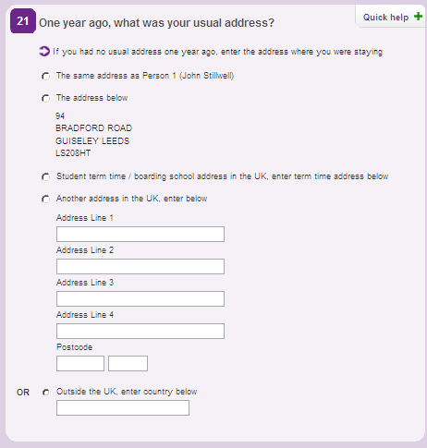
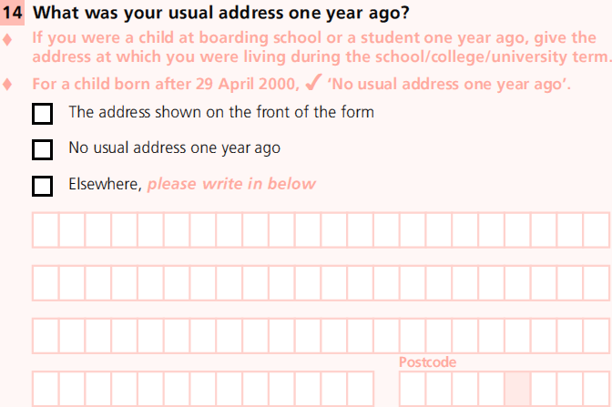
3.1 Migration question in 2011 similar to question in 2001
‘No usual address one year ago’ excluded ….. but ‘Student term time address..’ included
2011 2001

Slide 30
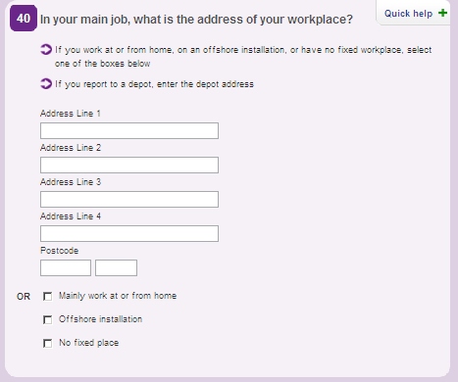
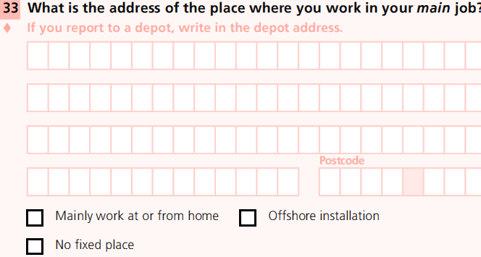
Commuting question also very similar
2011
2001

Slide 31
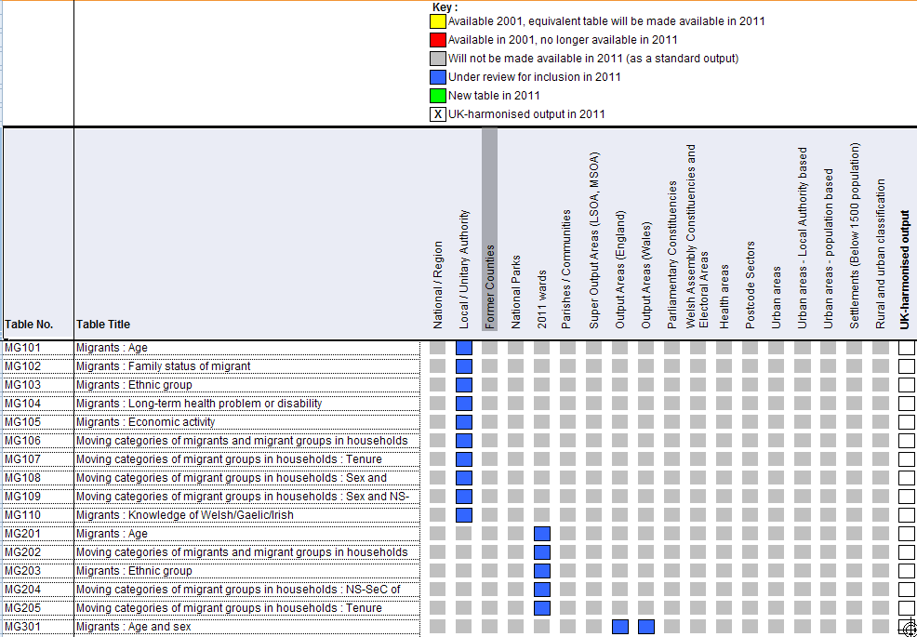
Migration tables in SMS still under review but look as though they are going to be the same
Source: ONS (2011) Proposed geographies for tables, http://www.ons.gov.uk/census/2011-census/consultations/open-consultations/2011-output-consultation---main-statistical-outputs---second-round/index.html

Slide 32
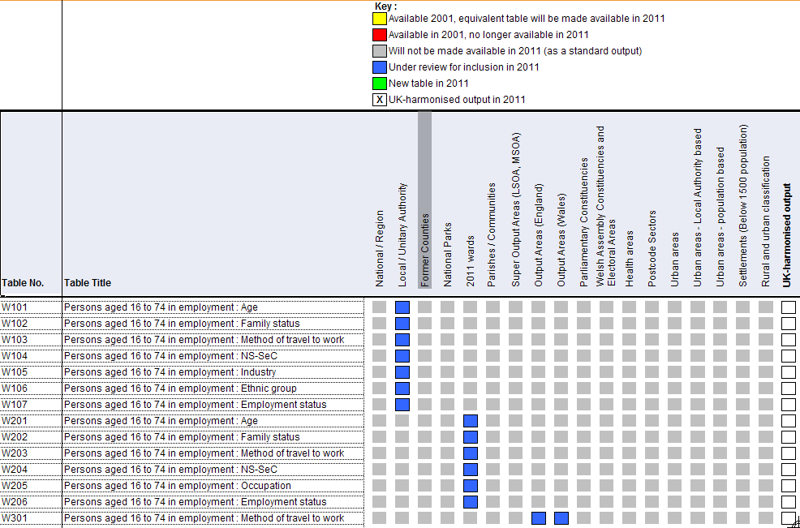
Same with commuting tables SWS/STS
Source: ONS (2011) Proposed geographies for tables, http://www.ons.gov.uk/census/2011-census/consultations/open-consultations/2011-output-consultation---main-statistical-outputs---second-round/index.html

Slide 33
New geography of commuting destinations: Workplace Zones (WPZs)
OAs based on where people live not work – can be unsuitable for workplace statistics
Some OAs contain no/few businesses; some contain many businesses or large employer, e.g. business parks, City of London
Workplace Zones project looking at splitting/merging OAs for a new geography constrained to MSOAs
Pilot areas: Tower Hamlets, City of London, Southampton, Nottingham, Suffolk Coastal
Disclosure control: Population threshold same as OAs (100 workers min; 625 max; no household threshold)
Source: Spicer, K. (2011) Statistical Disclosure Control for 2011 UK Census, http://www.ons.gov.uk/census/2011-census/consultations/open-consultations/2011-output-consultation---main-statistical-outputs---second-round/index.html

Slide 34
3.2 What about statistical disclosure control?
Small cell adjustment abandoned in favour of record swapping:
- Households swapped
- Targeted to ‘risky’ records
- Construct risk score for every individual; combine to household score
- Imputation considered as part protection
- Households swapped only as far as their risk is considered ‘high’
- Individuals swapped between communal establishments
Work on SDC on Origin-Destination Tables still ongoing
Source: Spicer, K. (2011) Statistical Disclosure Control for 2011 UK Census, http://www.ons.gov.uk/census/2011-census/consultations/open-consultations/2011-output-consultation---main-statistical-outputs---second-round/index.html

Slide 35
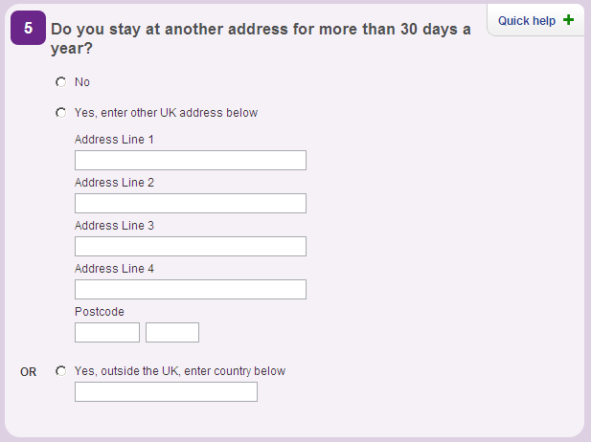
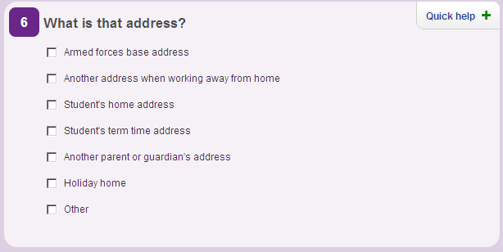
3.3 What new questions enable further ‘interaction’ data to be generated?
Questions 5 and 6 ask about another address
  Potential to produce matrices of interaction flows between usual address and other address – very useful for analyses of mobility (weekly commuting, shared custody of children, second homes, international mobility) hitherto uncaptured …… except for students

Slide 36
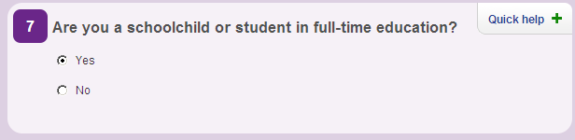

Student ‘migration’ picked up by separate questions

Slide 37
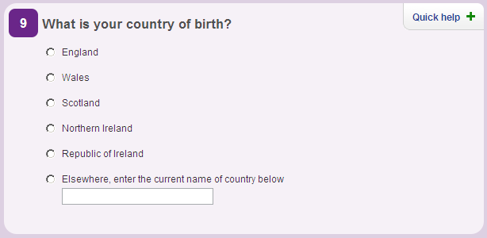
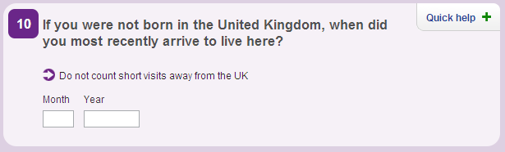
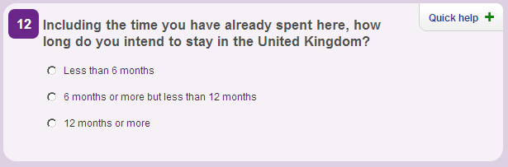
Questions about international immigration
NB. ONS could provide immigrants by country of birth and by country of previous residence if cross-classified with Question 21

Slide 38
4. Conclusions:
How will CIDER develop in the future?
Anticipation of substantial demand for access to 2011 Census interaction data sets
Continue to offer user access to data from previous censuses
Recognise the ‘new’ environment – with 2011 Census being the last census of its kind
Focus data from on surveys and administrative sources
ONS ‘Beyond 2011’ project and Integrated Population Statistics System
WICID will incorporate various non-census data sets and use same type of query interface for extraction and downloading

Slide 39
WICID will become a repository for all types of interaction data
CIDER already collecting other non-census data sets on:
(i) internal migration (e.g. NHS patient movement data time series from 1988-89 to 2008-09; HESA student flows)
(ii) international data (e.g. from a series of different administrative sources including GP Flag 4 registrations; NINo registrations; HESA statistics – all at district level)

Slide 40
Some challenges for WICID
Re-design the interface (and metadata) to present better classification of data sets
  List by source as well as by theme
Extending the interface to handle time-series data
  Easy selection of multiple waves of data of interest
  Time series analysis and summary functions
Extend the range of supported geographies
  Different types of geography (point locations as well as area)
  Clearly display of relevant geographies
Incorporation of ‘on-the-fly’ disclosure control routines for datasets like HESA
  Round data after aggregation but before giving to user
Improved mapping of results
  Flow maps of extracted data
  Choropleth maps of extracted data and analysis results

Slide 41
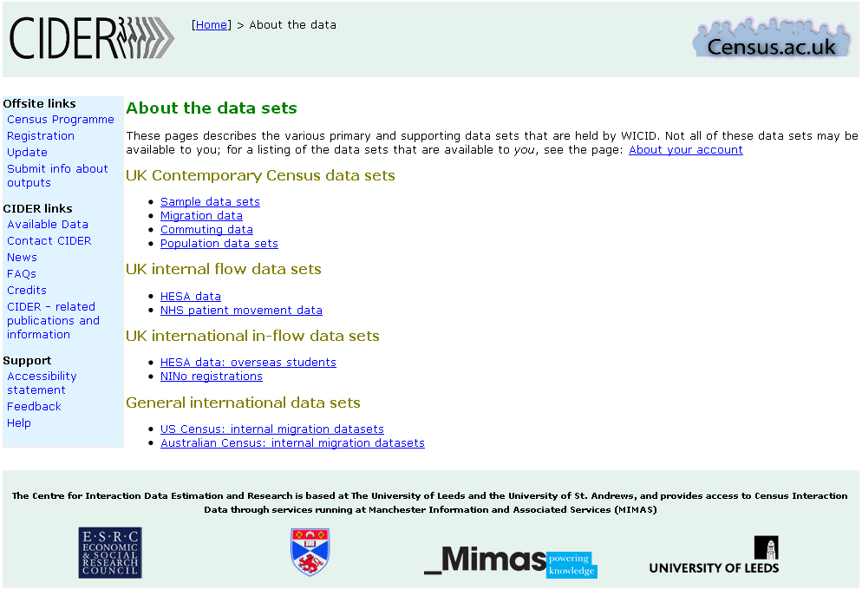
Improved data divisions

Slide 42
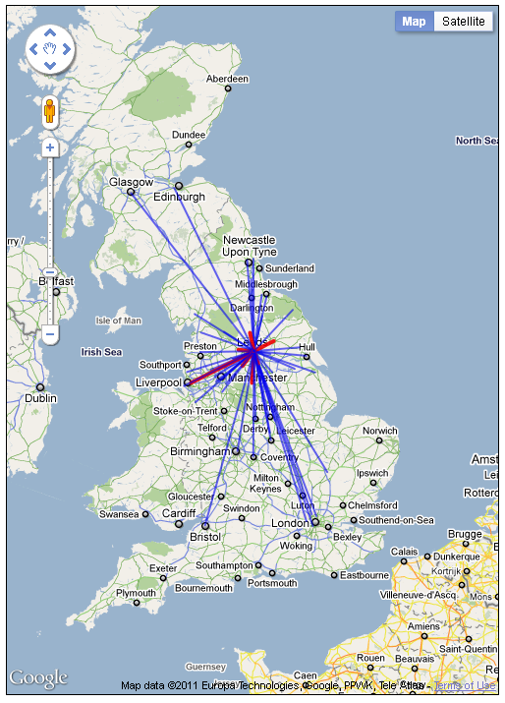

Slide 43
Changing access arrangements
Access arrangements for 2011 Census data are not yet known
  ONS concerned about disclosure risks in interaction data
  There may need to be a more secure path for spatially detailed data
  However, interaction data don’t necessarily fit the current security models
  Open Government Data models suggest easier access to data, not harder access

Slide 44
The benefits of an API based system
Delivery of data via an API offers close linking of values with their corresponding metadata
  This should make it easier to match data items with the right populations when calculating rates
Makes it easier to add new specialised aggregations as they become available
Easier to re-purpose ONS data
Allow WICID to become a value-adding conduit for data

Slide 45


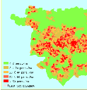


WICID application
WICID RESTful API?
ONS Read API
system
ONS 2011 data repository
?
ONS 2001 data
Legacy Census data
(CIDER)
Other data sources
ONS pre-2001 data

Slide 46
ONS web environment

Slide 47
Contact details
John Stillwell
Email: j.c.h.stillwell@leeds.ac.uk
Oliver Duke-Williams
Email: o.w.duke-williams@leeds.ac.uk
CIDER
Web site: http://cider.census.ac.uk/

