Slide 1
Introduction to international migration data
Oliver Duke-Williams
Adam Dennett

Slide 2
Presentation Outline
International migration - definitions
An overview of main, freely available, global international migration datasets
Introduction to census international migration datasets
Conclusions

Slide 3
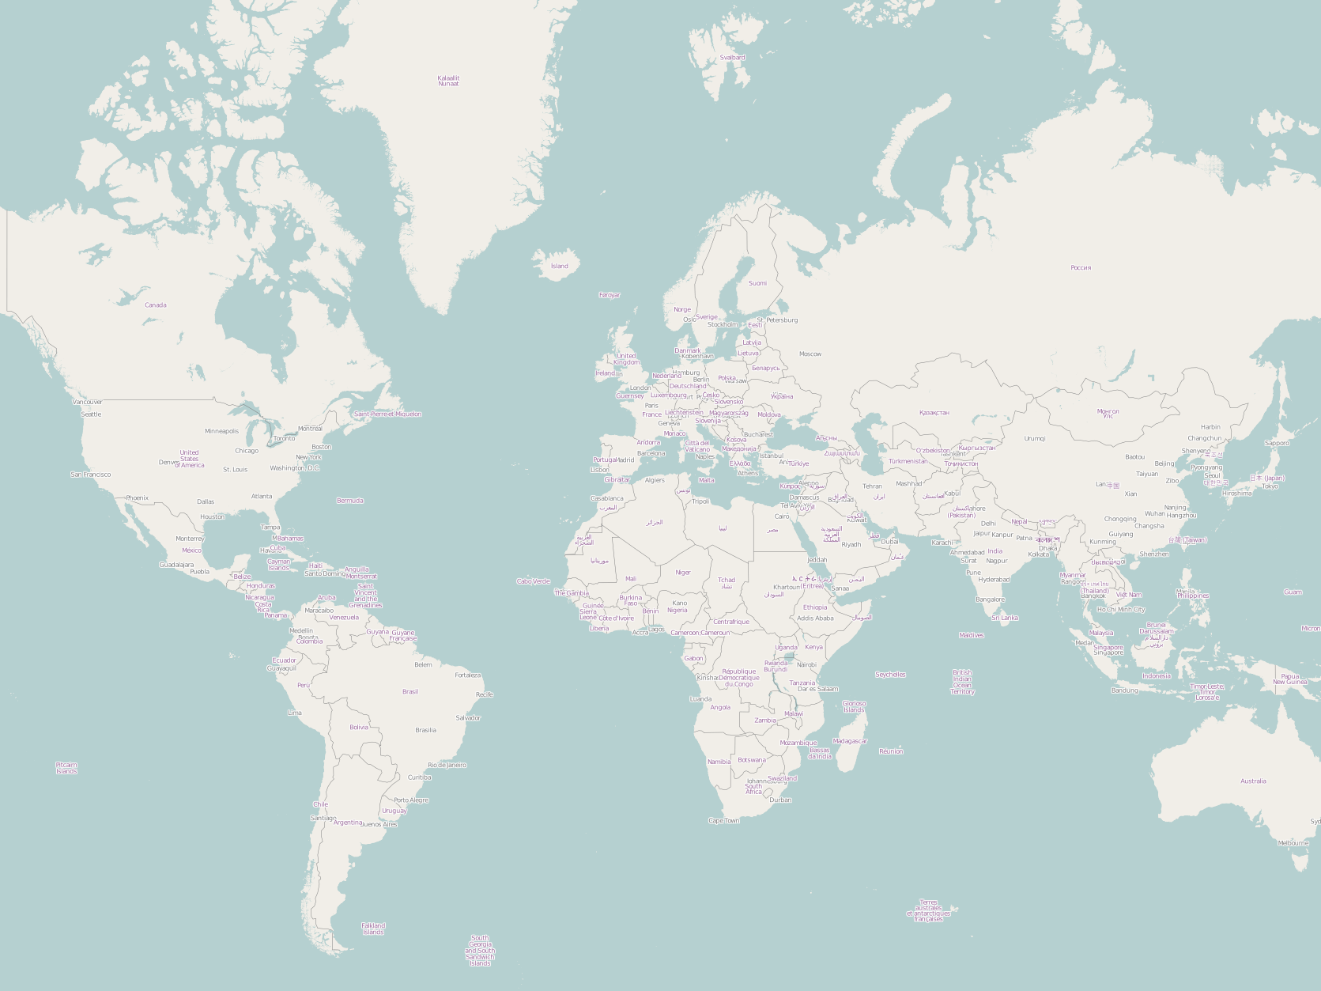



Deaths and acquisition of citizenship make it difficult to compare stocks to estimate flows, although data on both exist for some countries…
UN: “the crossing of the boundary of a political or administrative unit for a certain minimum period of time”
Migration event/flow
Flows feed into stock data, but estimating flows from stocks not straight forward… not simply a matter of: flow = stock t – stock t-1
Migrants who remain in their new countries form migrant ‘Stocks’ - these data are usually collected through censuses or registers. Stocks updated by new data or demographic models and more widely available than flow data
Migrant
Flow data record origins and destinations of migrants over a defined period (1yr, 5yr etc.) - globally poor quality/limited availability. Issues of comparability – are all migrants ‘migrants’?
2 types of stock data:
Foreign born by country of birth
Foreign born by country of nationality/citizenship
Both not available for all countries Temporal availability varied also
Timeline
2000
2001
2002
2003
2004
2005
2006
2007
2008
2009

Slide 4
Migrant Stocks – UN Data
Global migrant stock data are collected regularly by the United Nations – empirical data available through:
United Nations Global Migration Database v.0.3.6
http://esa.un.org/unmigration/
Registration required
Stocks by Origin/Destination + time series

Slide 5
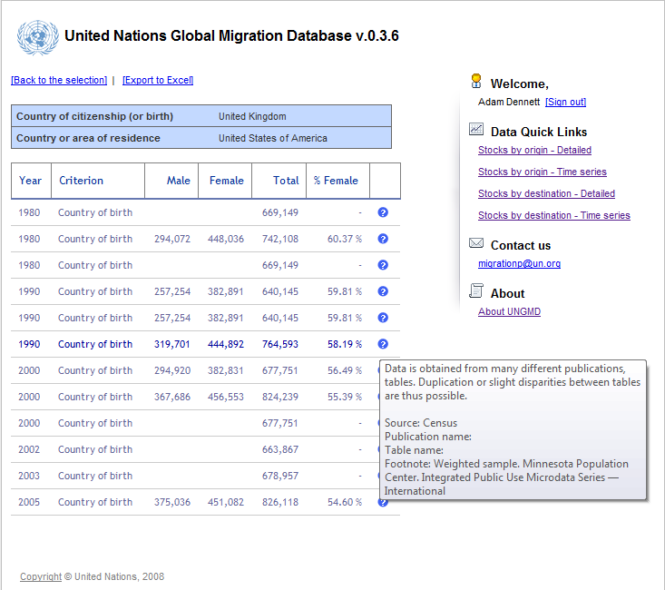

Slide 6
Migrant Stocks – UN Data
UN has further data available without the need to register:
http://esa.un.org/migration/
Data from latest (2008) revision of international migration stock including some estimates
http://esa.un.org/MigAge/
Same data disaggregated by age and sex

Slide 7
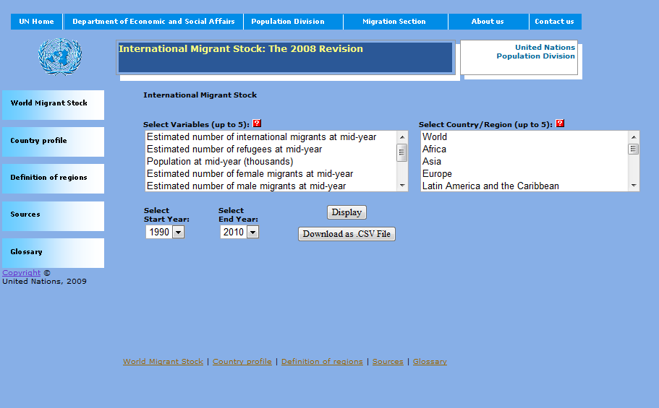

Slide 8
So, what do we know? Global Migration – foreign born
Source: http://esa.un.org/migration/

Slide 9
% distribution of international migrants by age and sex

Slide 10
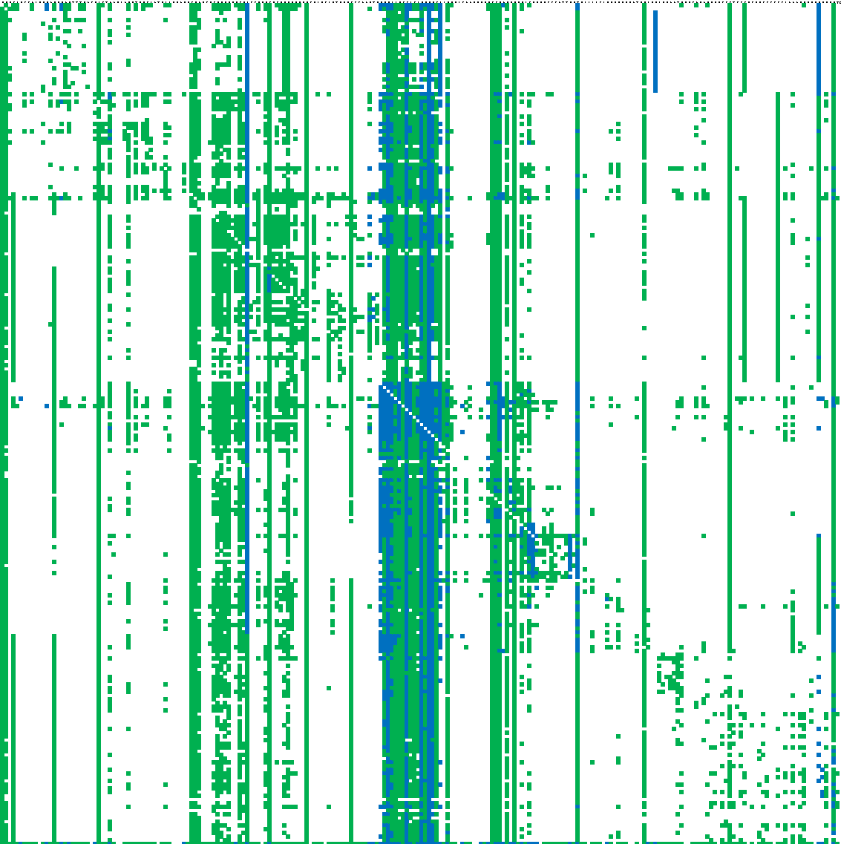
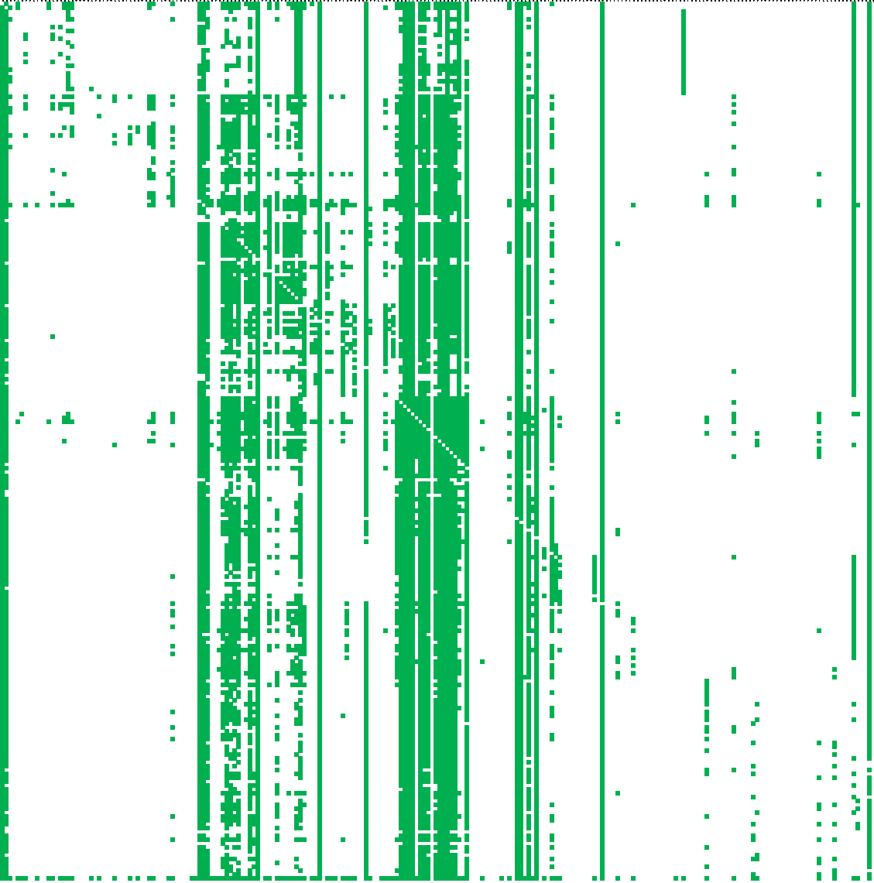
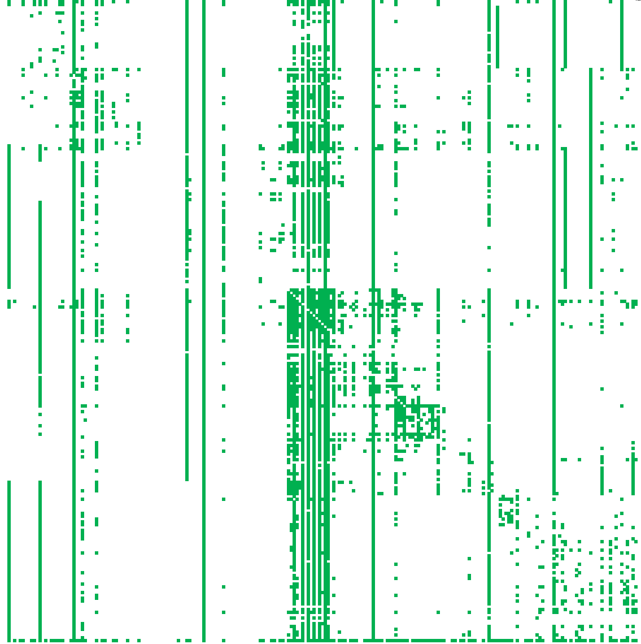
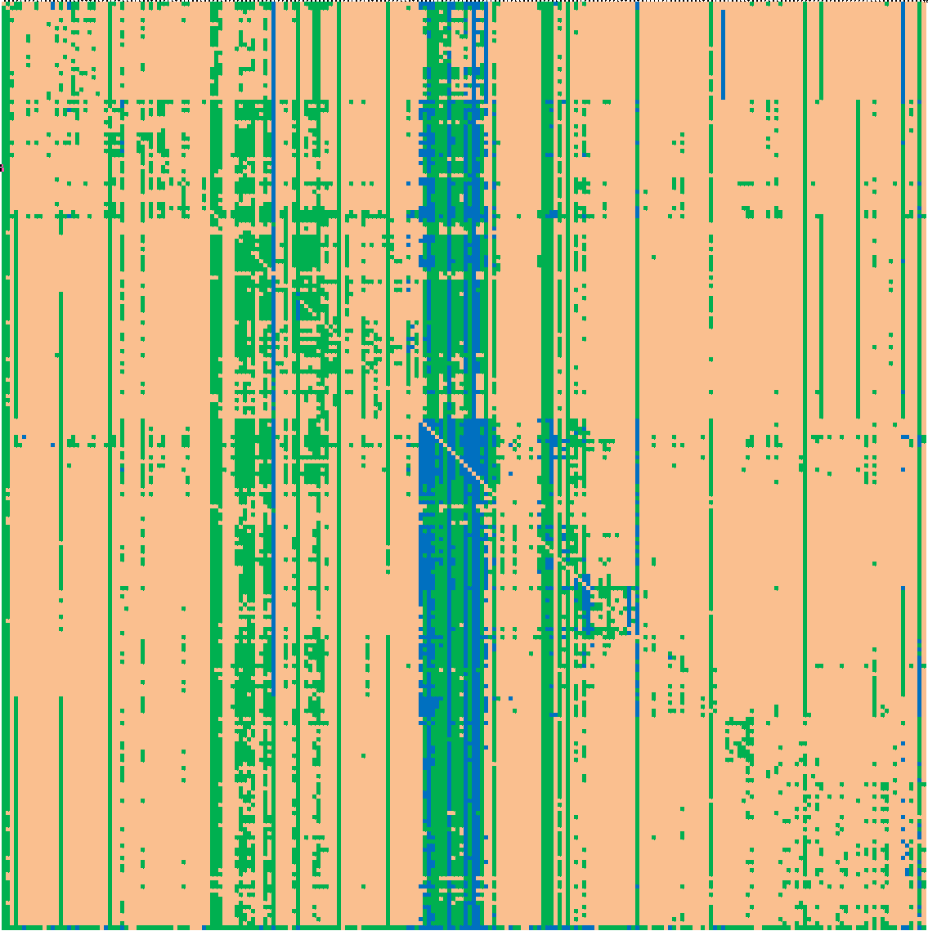
Sussex Global migrant origin stock database
Foreign Born
Foreign National
Work by team at Sussex has estimated full 226 x 226 O/D stock matrix (2004)

Slide 11
Sussex – Global Migrant Origin Database
Tables from the Development Research Centre on Migration (University of Sussex) global migrant origin database (based on data from 2000-02 census rounds – UN Stocks, 2005 revision).
Global Migrant Origin Database v1 - Foreign Born & Foreign National
Global Migrant Origin Database v2 - Foreign Born & Foreign National
Global Migrant Origin Database v3 - Foreign Born & Foreign National
Global Migrant Origin Database v4
Migrant stock data - versions have increasingly greater numbers of cells filled with modelled and estimated data – v4 full matrix 227/227 OD stocks.
http://www.migrationdrc.org/research/typesofmigration/global_migrant_origin_database.html

Slide 12
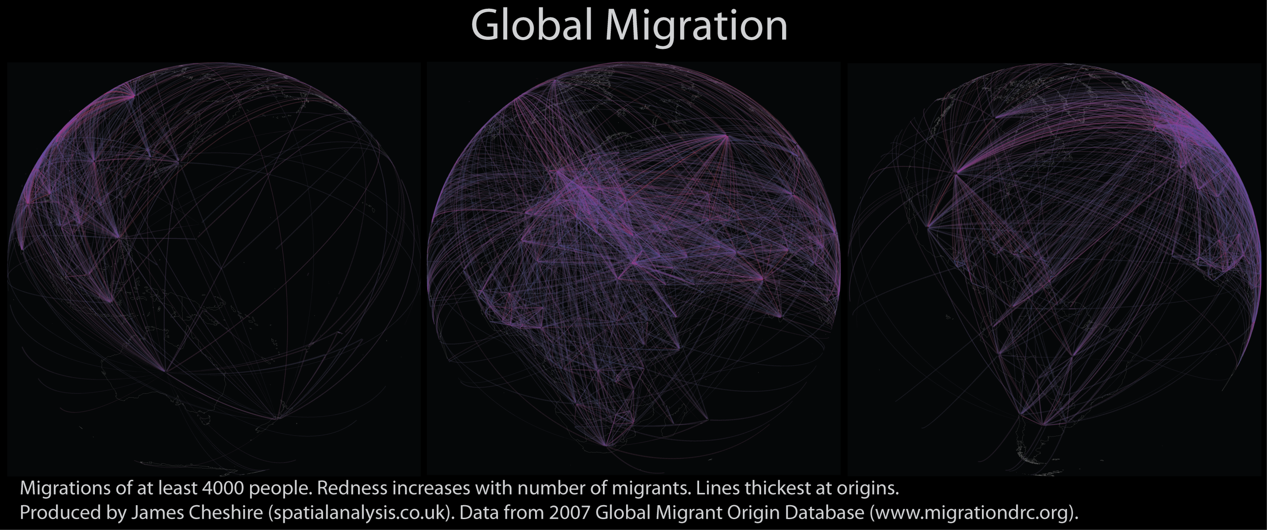

Slide 13
Migrant Flows – Cohen et al.
Cohen, J., Roig, M., Reuman, D., and GoGwilt, C. (2008), 'International migration beyond gravity: a statistical model for use in population projections', Proceedings of the National Academy of Sciences, 105 (40), 15269-74.
Time series flow data 228 Origins to 195 Destinations – 1960-2004
Data collated from 11 countries – very sparse matrix, but unique collection of data
http://www.pnas.org/content/105/40/15269/suppl/DCSupplemental

Slide 14
Eurostat – Flow and Stock data
New Cronos database
Data on International (extra-Europe and intra-Europe) immigration and emigration (country of birth, country of previous residence and country of citizenship)
Comprehensive in scope (all international origins possible – national and sub-national data) but patchy in coverage
Time series back to 1998 in many instances
Stock data AND flow data are available to download

Slide 15
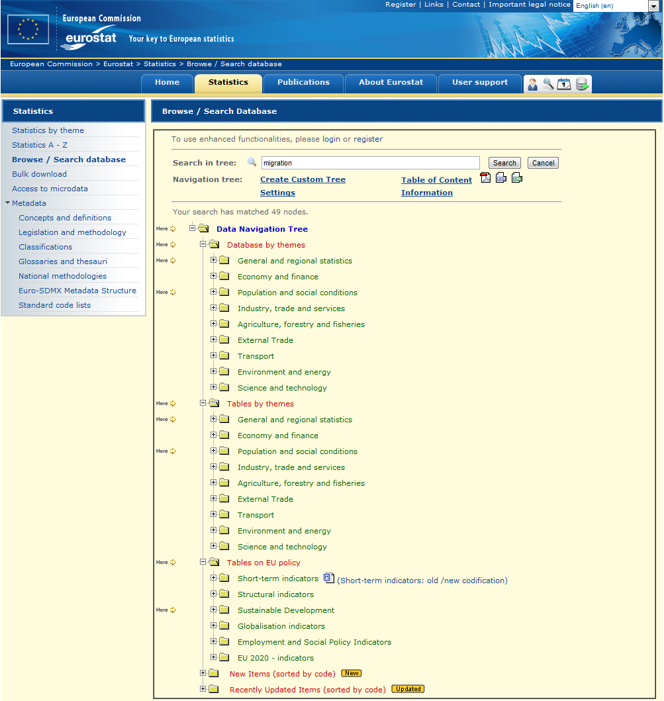
Database is continually updated with new datasets
http://epp.eurostat.ec.europa.eu/portal/page/portal/statistics/search_database

Slide 16
European flow data – MIMOSA, IMEM
Issues of incomplete data and data harmonisation (flows reported by origin do not often match those reported by destination) – need to reconcile differences and estimate gaps
MIMOSA European migration flow data estimates – 2002-2007. 31X31 inter-country flow matrices for Europe
http://mimosa.gedap.be/
IMEM – current project looking to improve upon earlier MIMOSA work
http://www.norface-migration.org/currentprojectdetail.php?proj=3

Slide 17
OECD stock and flow data
http://stats.oecd.org
28 OECD country destinations x full list global origins
Database:
    immigrants in OECD countries
    international migration stock and flow
Data freely available online

Slide 18
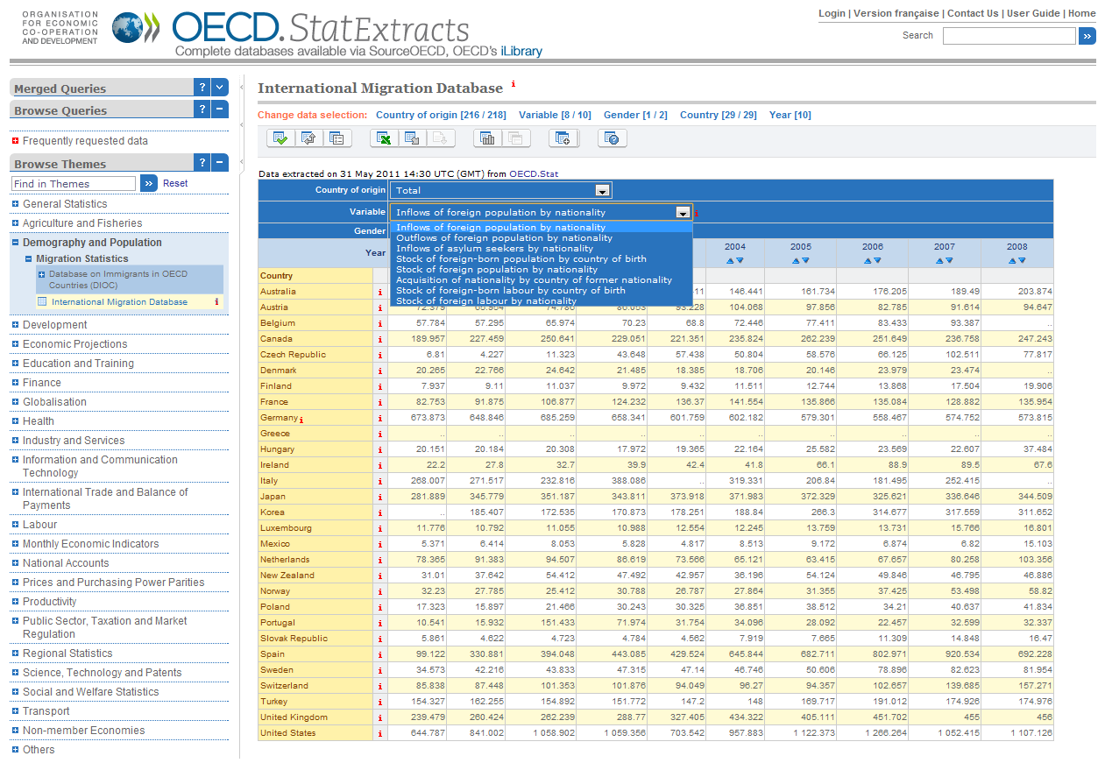

Slide 19
OECD stock and flow data
Data in OECD database collected as part of the Continuous Reporting System on Migration (SOPEMI) – these data have not been harmonised internationally
Data on international migration flows for the UK delivered to SOPEMI are derived from the Labour Force Survey
A sample of only around 300,000 people annually

Slide 20
International Census data?
Whilst regular, Labour Force Surveys are relatively small samples and are generally not imperfect for reliable national analyses (huge variation in numbers due to weighting for e.g.)
Various national statistical agencies collect data on international migration data in censuses and population registers
Little work had been carried out on collecting and collating this data until recently…
Team at Vienna working on this now – watch this space…
http://www.oeaw.ac.at/vid/

Slide 21
International migration in UK Censuses
Area Statistics
Samples of Anonymised Records
Special Migration Statistics

Slide 22
Area Statistics
1991
  Migrants from outside GB
2001
  Migrants from overseas tabulated in Standard Tables
    All from ‘outside UK’ by age, sex, household structure
‘Lifetime migration’ from country of birth

Slide 23
Samples of Anonymised Records
1991 SARs: Origin outside GB
2001 SARs: Origin outside UK
2011 SARs: Origin outside UK (?)

Slide 24
Special Migration Statistics
SMS produced from 1981, 1991 and 2001 Censuses
  Similar data from 2011 expected
Tabulate flows from all origins to all destinations

Slide 25
1981 SMS
92 foreign origins
10,000+ wards of residence
Migrants by sex

Slide 26
1981 SMS continued
‘Foreign origins’ include
  Component parts of British Isles
  Distinct countries
  Groups of countries
  Regional / continental remainders
  ‘Rest of world’, ‘Elsewhere’
  Includes some non-specific cases
    eg ‘Ireland – part not stated’

Slide 27
1991 SMS
98 foreign origins
  Again, a mix of different things
10,000 wards as destinations
Available attributes vary by scale
  At ward level: age & sex
  At district level: marital status, ethnic group, LLTI, economic position, tenure, Welsh and Gaelic speakers
    But, subject to suppression
Notes:
In contrast to the area statistics – which simply tell us what proportion of the population of a given ward or district etc were immigrants, the SMS allow us to disaggregate these by origin.
In principle, we can disaggregate by other characteristics as well, although all except for age and sex are subject to suppression, so we don’t really get a real perspective.

Slide 28
2001 SMS
In standard SMS, only ‘Origin outside UK’
  Available down to OA level, but heavily affected by Small Cell Adjustment
  Attribute detail varies with destination geography
OA | Ward | District
Age [3] * sex | Age [16] * sex Ethnic group [2] * sex | Age [24] * sex Family status * sex Ethnic group [7†] * sex LLTI * whether in hhld * age * sex Economic activity * sex Knowledge of Welsh/Gaelic/Irish * age * sex
Individual level attribute data

Slide 29
2001 C0711
One of a set of many commissioned tables
Consists of 3 sections
C0711B gives
  58 foreign origins (usual mix)
  367 district level destinations
    England and Wales only
  Persons by ethnic group [7 categories]
  Suffers from SCAM effects

Slide 30
Comparison of three Censuses
What patterns do we see?
Which countries can be consistently compared?
Do the data mean the same thing?

Slide 31
1991: all foreign origins
Total persons
All origins
13 - 373
374 - 1004
1005 - 2616
2617 - 9517
Source: 1991 Census Special Migration Statistics (Great Britain)

Slide 32
1991: migrants from Republic of Ireland
Source: 1991 Census Special Migration Statistics (Great Britain)

Slide 33
1991:migrants from West Germany
Source: 1991 Census Special Migration Statistics (Great Britain)

Slide 34
1991: migrants from all foreign origins
Source: 1991 Census Special Migration Statistics (Great Britain)

Slide 35
1991: migrants from USA and Australia
Source: 1991 Census Special Migration Statistics (Great Britain)

Slide 36
1991: migrants from Israel
Source: 1991 Census Special Migration Statistics (Great Britain)

Slide 37
1991: migrants from Nigeria and Uganda
Source: 1991 Census Special Migration Statistics (Great Britain)

Slide 38
1991: migrants from India, Pakistan and Bangladesh
Source: 1991 Census Special Migration Statistics (Great Britain)

Slide 39
2001
Migrants from all foreign origins
Source: 2001 Census Commissioned output C0711

Slide 40
2001
Migrants from France
Source: 2001 Census Commissioned output C0711

Slide 41
2001
Migrants from Pakistan
Source: 2001 Census Commissioned output C0711

Slide 42
Which countries can be consistently compared?
There are 36 countries which appear as origins in all three Censuses
  Labelling varies in some cases – possible changes?
    Eg “France” v “France inc. Monaco”
  Political status of many countries has changed (e.g. Membership of EU)

Slide 43
Ever-present countries
Europe
  Belgium, Denmark, Finland, France, Greece, Italy, Ireland, Luxembourg, Netherlands, Norway, Poland, Portugal, Spain, Sweden, Switzerland
Middle East
  Turkey, Cyprus, Israel
Africa
  Kenya, Nigeria, South Africa, Zimbabwe
North America / Caribbean
  USA, Canada, Jamaica
Asia
  India, Pakistan, Bangladesh, Sri Lanka
  China†, Hong Kong, Japan, Philippines, Malaysia, Singapore
Australasia
  Australia, New Zealand
Notes:
China isn’t quite right – it includes Taiwan in some rounds

Slide 44
Do the data mean the same thing?
Changes in base population
Changes in country status
Differential handling of unstated origins

Slide 45
Conclusions
Global sources of international migration data are sparse, with matrices of stocks and flows sparser still
Freely available data do exist, but with a number limitations on top of matrix sparseness: varying definitions, limited time-series, unreliable survey sources, origin/destination harmonisation etc.

Slide 46
Conclusions
The 1991 data provide detailed flows
The 2001 data are heavily affected by SCAM
  An alternative commissioned set would be useful
It will be important to make sure that outputs from the 2011 are of higher quality

