Slide 1
Interaction Data
John Stillwell and Oliver Duke-Williams
Centre for Interaction Data Estimation and Research (CIDER)
School of Geography, University of Leeds
Presentation at
‘Census Resources for Research’ Conference Centre, The British Library,
London, 12 April

Slide 3
Presentation
What has CIDER achieved over the last 5 years?
How have the interaction data sets been used in research?
What potential does the 2011 Census provide for data provision and research?
Conclusions: How will CIDER develop in the future?

Slide 4
1. What has CIDER achieved over the last 5 years?
1.1 Assembly and storage of large volume of origin-destination data sets
1.2 Development of important online interface (WICID) to the Census interaction data sets
1.3 Provision of training and advice to users
1.4 Research using the interaction data sets

Slide 5
1.1 Assembly and storage of large volume of origin-destination data sets
CIDER’s audit of interaction data from various sources
Censuses of Population – comprehensive, reliable migration and commuting data, particularly for flows within and between small areas
Administrative records – collection of records arising from some transaction, registration or record of service delivery
Social surveys – population samples allowing useful cross-classification at national (regional) level
See Dennett, A., Duke-Williams, O. and Stillwell, J. (2007) Interaction data sets in the UK: An audit, Working Paper 07/05, School of Geography, University of Leeds (http://www.geog.leeds.ac.uk/research/wpapers)

Slide 6
CIDER’s interaction data sets
Census data sets
Origin-Destination Statistics
1981 SMS Set 2 and SWS Set C (County/region level)
1991 SMS Sets 1 and 2, SWS Sets A-C and Table 100 (students)
2001 SMS Sets 1 and 2, SWS/STS Levels 1-3 (and postal sectors)
Commissioned Tables
Set of tables from 2001 Census including, for example:
C0649: Commuters by religion at district level
C0711: Migrants by ethnic group and age at district level
C0723: Migrants by age and ethnic group at region/ward level

Slide 7
CIDER’s interaction data sets
Derived or estimated data
SMSGAPS: Counts for SMS Set 2 Tables 3-10 derived by Rees and Duke Williams that include estimates of suppressed values
MIGPOP: Counts for SMS Set 2 Table 3 derived by Simpson and Middleton that adjust for under-enumeration
1981 SMS Set 2 (wards) and SWS Set C (wards): re-estimated for 1991 and 2001 geography by Boyle and Feng
1991 SMS Set 1 (wards) and SWS Set C (wards): re-estimated for 2001 geography by Boyle and Feng

Slide 8
CIDER’s interaction data sets
Administrative data
Patient register/NHSCR flows between local authority districts in England and Wales, 1999-2008 (rounded) – estimated and supplied by ONS
Inter-NUTS2 region migration estimates for UK, mid 1999-2000 to mid 2006-2007 – estimated and supplied by Rees and Dennett (DEMIFER project)
Inter-NUTS2 region migration estimates for UK, calendar year 2000 to 2006-2007 – estimated and supplied by Rees and Dennett (DEMIFER project)
Inter-region migration by age, sex and ethnicity for Britain, 1991-1999 and 2000-2007 estimated and supplied by Raymer and Giuletti (ESRC project)
Inter-county migration by age, sex and ethnicity, 1999-2007, estimated and supplied by Raymer and Giuletti (ESRC project)
Inter-county migration by age, sex and economic activity , 1999-2007, estimated and supplied by Raymer and Giuletti (ESRC project)

Slide 9
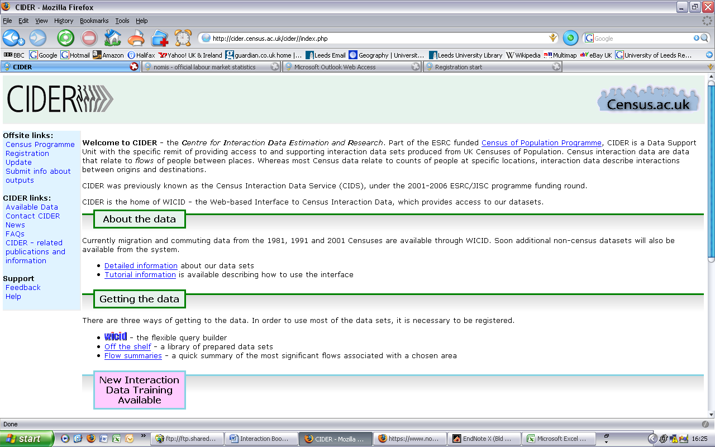
1.2 Development of important online interface to the Census interaction data sets
CIDER Home Page
Need to be a registered user of census data

Slide 10
WICID Query Interface

Slide 11
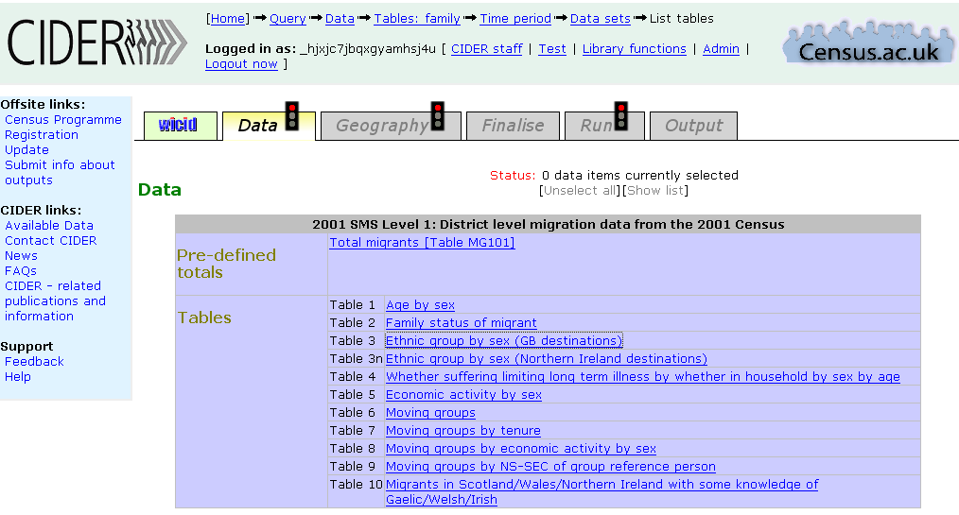
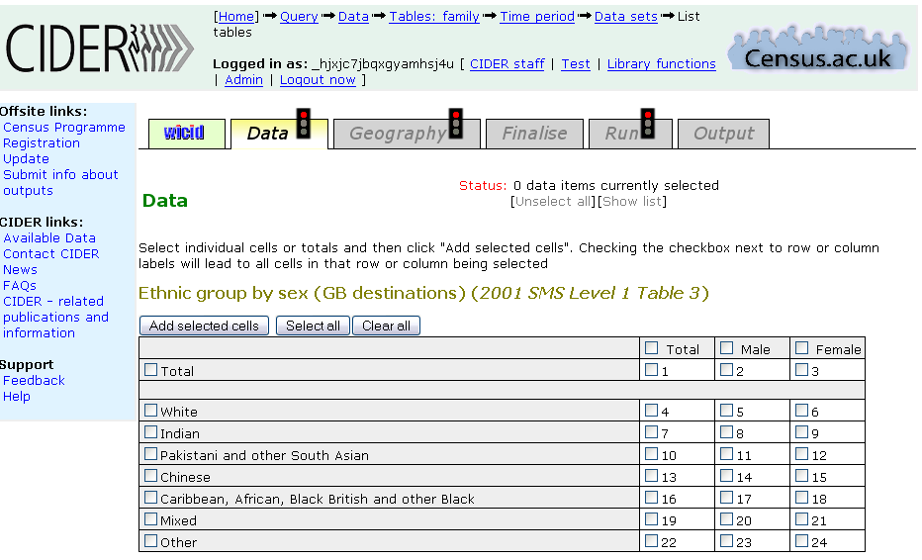
Data selection
Tables available in 2001 SMS Level 1
Cells of Table 3 in 2001 SMS Level 1

Slide 12
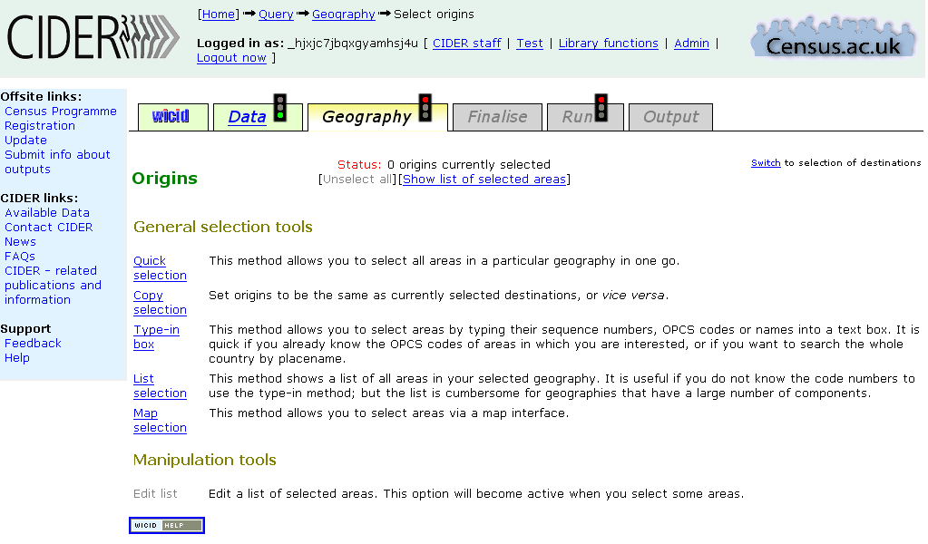
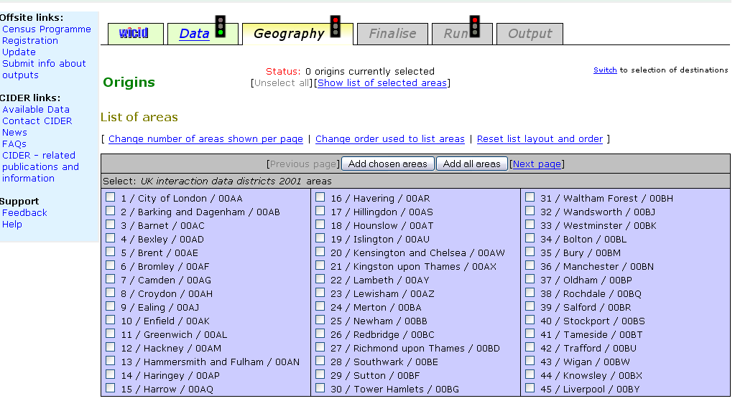
Geography selection
Area selection tools available
List selection of districts

Slide 13
Map Selection Tool

Slide 14
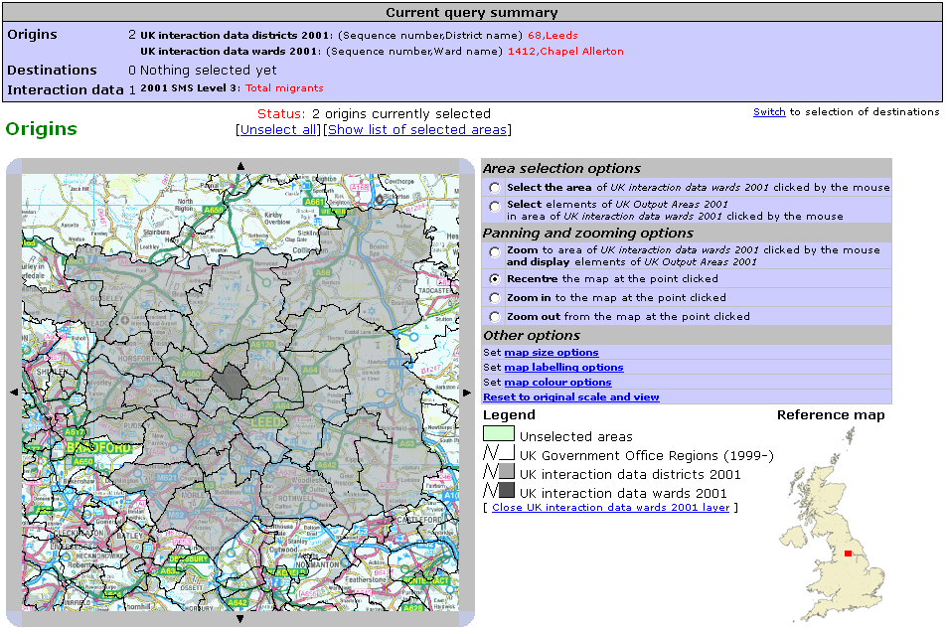
Map Selection Tool (detail)

Slide 15
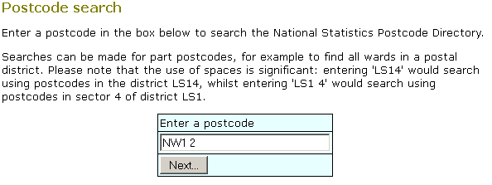
Postcode based selection

Slide 16
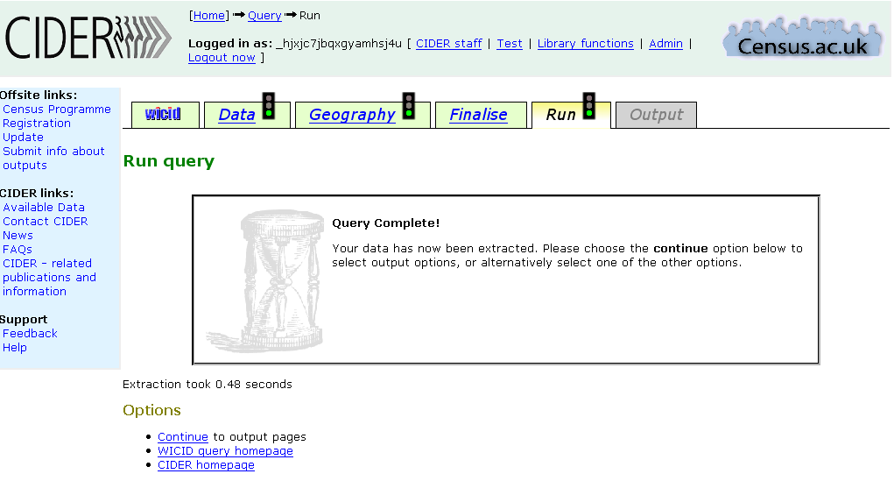
Finalise Screen
Screen Indicating Extraction Completed

Slide 17
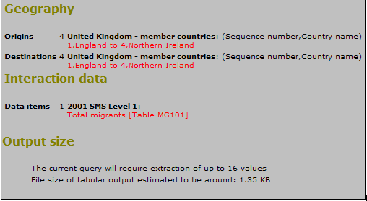
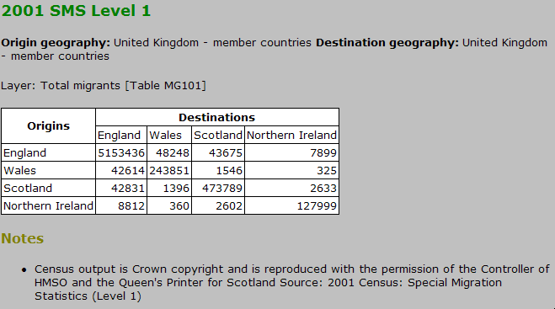
Example of simple query and data extracted
The Query: Extract the data on total migrant flows between the countries of the UK from Table MG1010 in 2001 SMS
The Data: Origin by destination matrix of migration flows in 2000-01

Slide 18
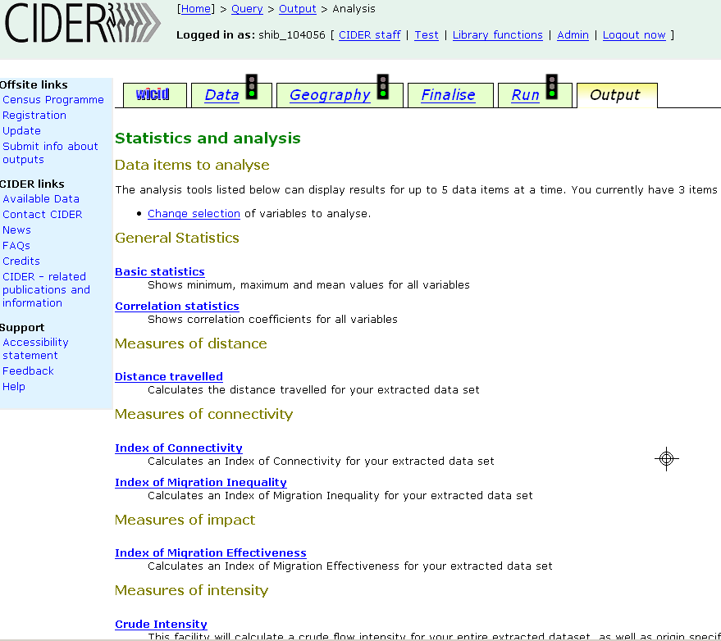
Analysis functions for use on extracted data

Slide 19
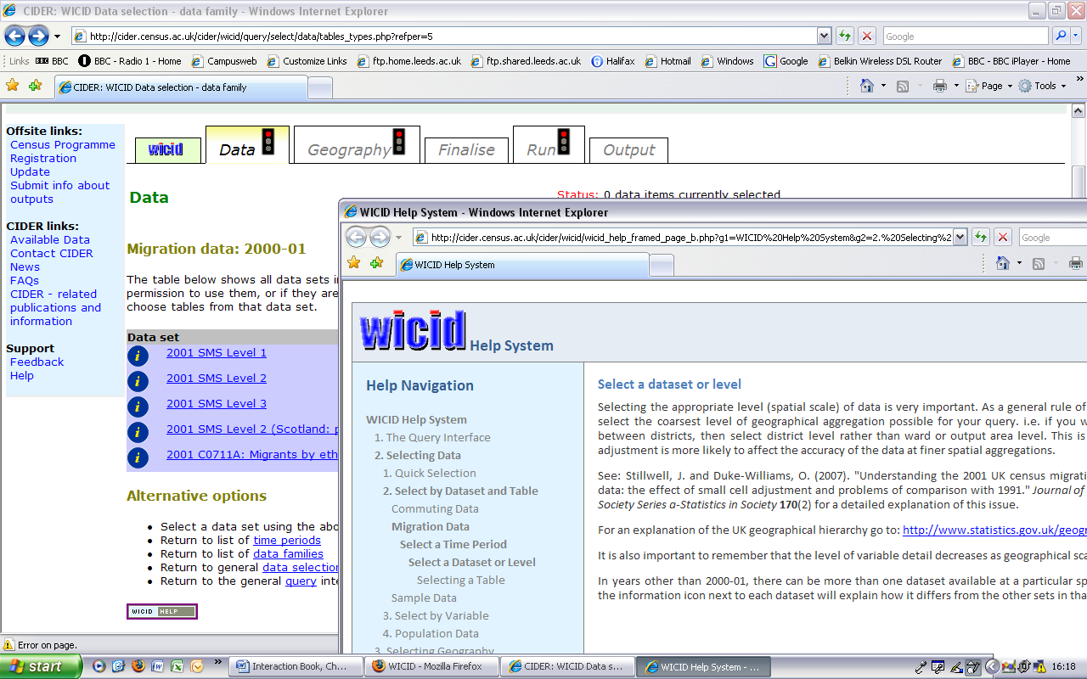
Help System opening inside a new browser window

Slide 20
1.3 Provision of training and advice to users
Census Programme training workshops
Classroom exercises (Stillwell, 2006b; Dennett, 2010)
Bespoke support for research users – particularly those requiring large sets of data
Tutorial materials (CHCC project):

Slide 21
2. How have the interaction data sets been used in research?
2.1 Interaction data sets used by various researchers
See some examples in Part 2 of CIDER book:
Stillwell, J., Duke-Williams, O.W. and Dennett, A. (eds.) (2010) Technologies for Migration and Commuting Analysis Spatial Interaction Data Applications, pp. 357, IGI Global, Hershey.

Slide 22
2.2 CIDER research
Measurement of the impact of SCAM (Stillwell and Duke-Williams, 2006; Duke-Williams and Stillwell, 2007)
Audit of all interaction data sets (Dennett et al., 2007)
Student migration (Duke-Williams, 2009)
Analysis of internal migration using area classification (Dennett and Stillwell, 2009; 2010)
Development of migration-based LAD classification (Dennett, 2010; Stillwell and Dennett, 2011; Dennett and Stillwell, 2011)
Ethnic internal migration (Stillwell, 2010; Stillwell and Hussain, 2010)
Analysis of time series NHS data (Stillwell and Duke Williams, 2010)

Slide 23
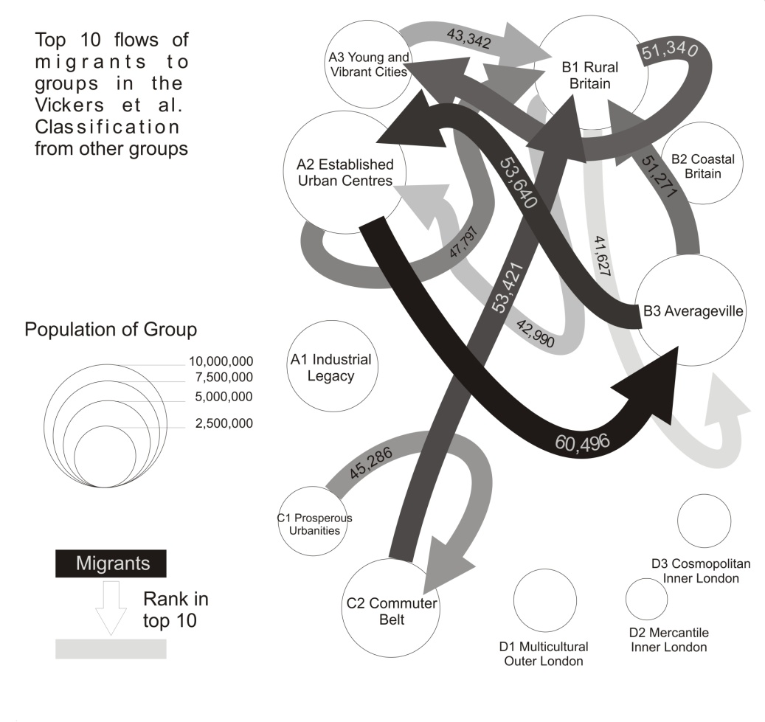
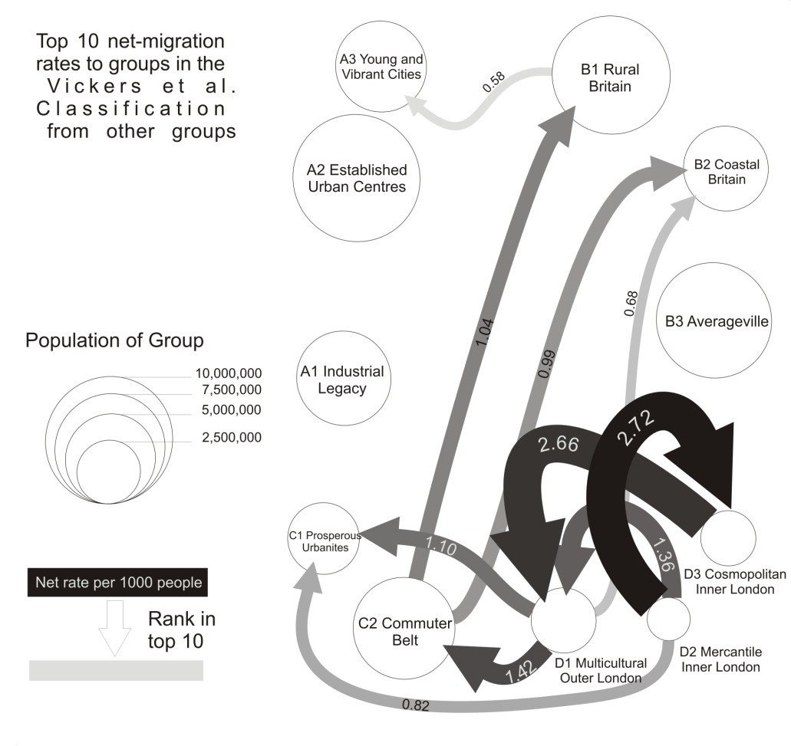
Example 1: Migration patterns based on Vickers et al. (2003) district classification
.
Top ten directional flows and net migration rates between area clusters, 2000-01
Directional migration flows Net migration rates
Source: Dennett, A. and Stillwell, J. (2010) Internal migration in Britain, 2000-01, examined through an area classification framework, Population, Space and Place, 16(6): 517-538.

Slide 24
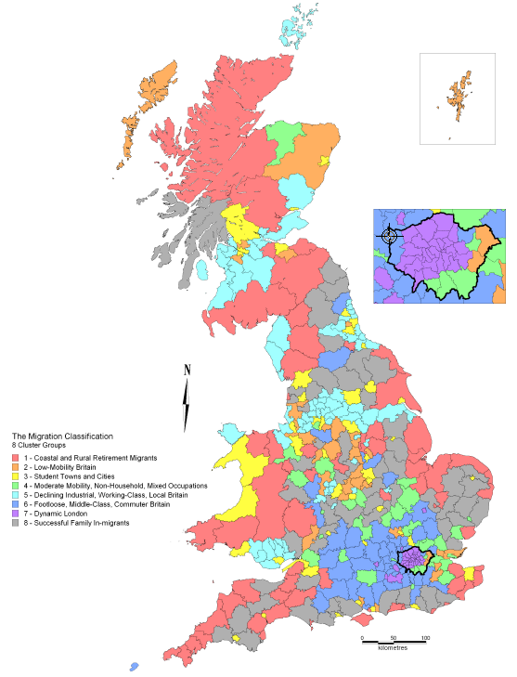
Example 2: Migration-based District Classification for GB
District classification
408 districts used
56 migration variables selected
and standardised
Euclidian distance used as measure
of proximity
k-means algorithm used for clustering
Optimal solution is 8 clusters
Source: Dennett, A. (2010) Understanding internal migration in Britain at the start of the 21st century, PhD Thesis, School of Geography, University of Leeds.

Slide 25
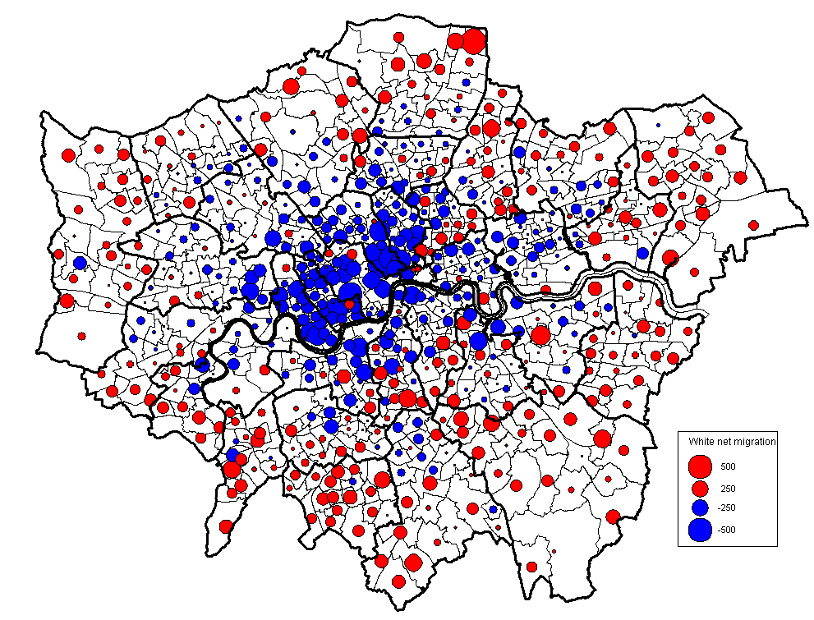
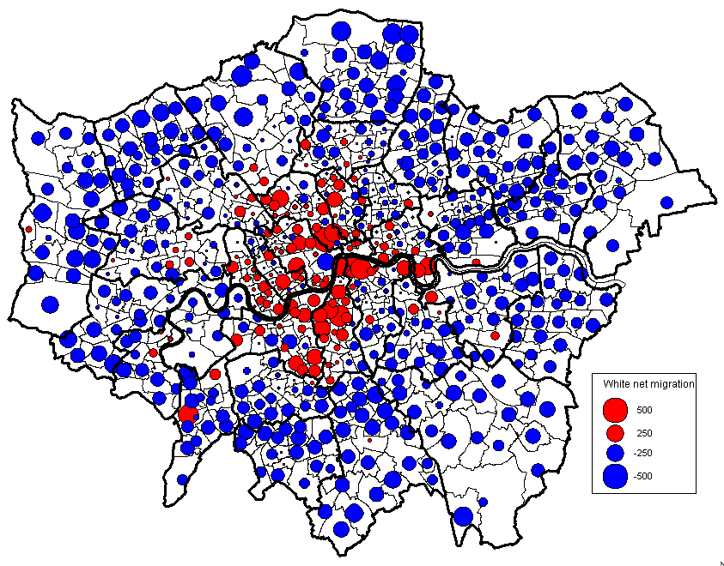
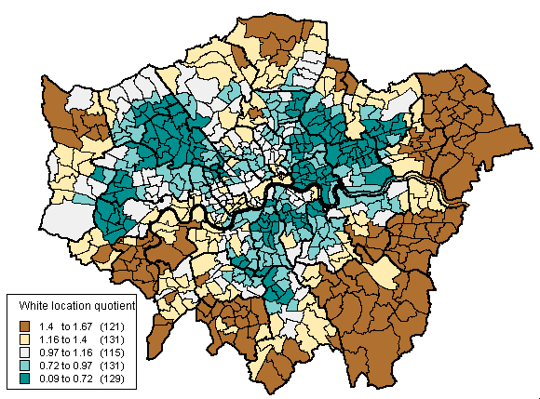
Example 3: What processes of white migration are taking place in London at ward level?
Net migration flows within Net migration flows between Greater London London and rest of England and Wales
Source: 2001 Census Commissioned Table
Stillwell, J. (2010) Ethnic population concentration and net migration in London, Environment and Planning A, 42: 1439-1456.
Location quotients

Slide 26
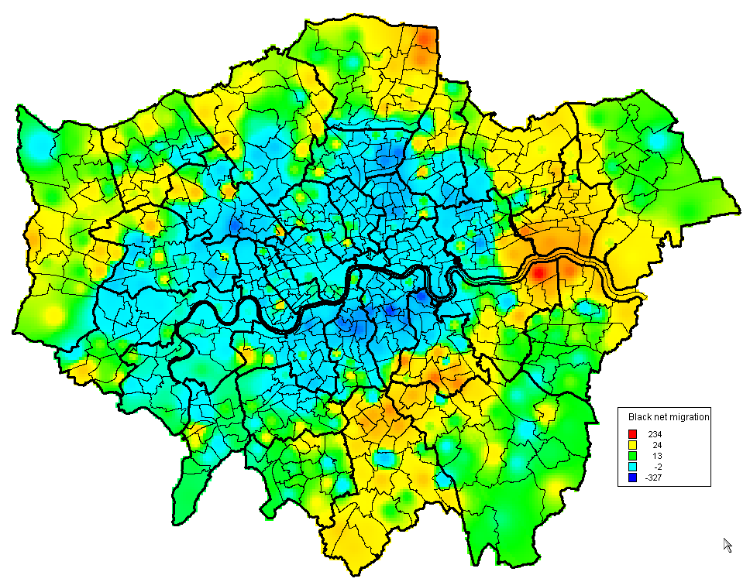
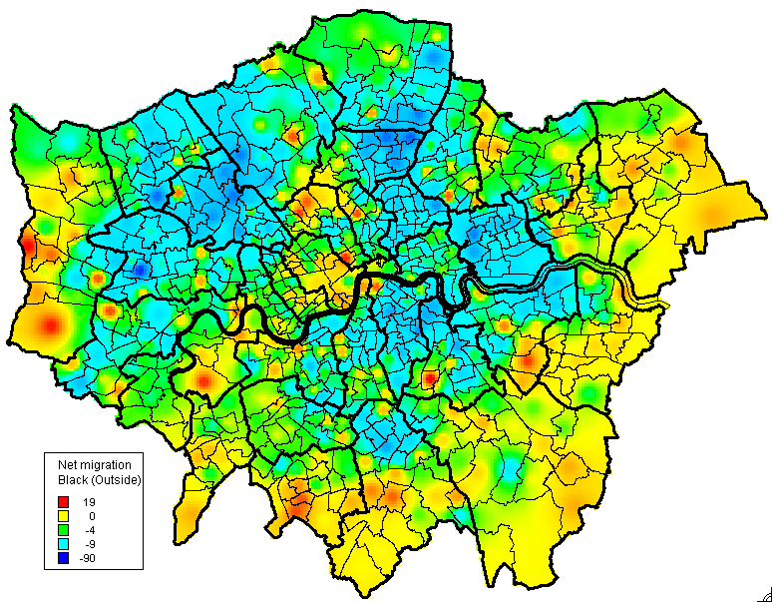
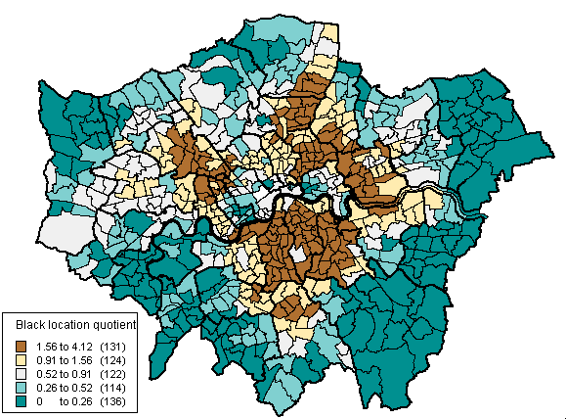
Are the same processes of migration apparent for Black migrants in London?
Net migration flows within Net migration flows between Greater London London and rest of England and Wales
Source: 2001 Census Commissioned Table
Location quotients

Slide 27
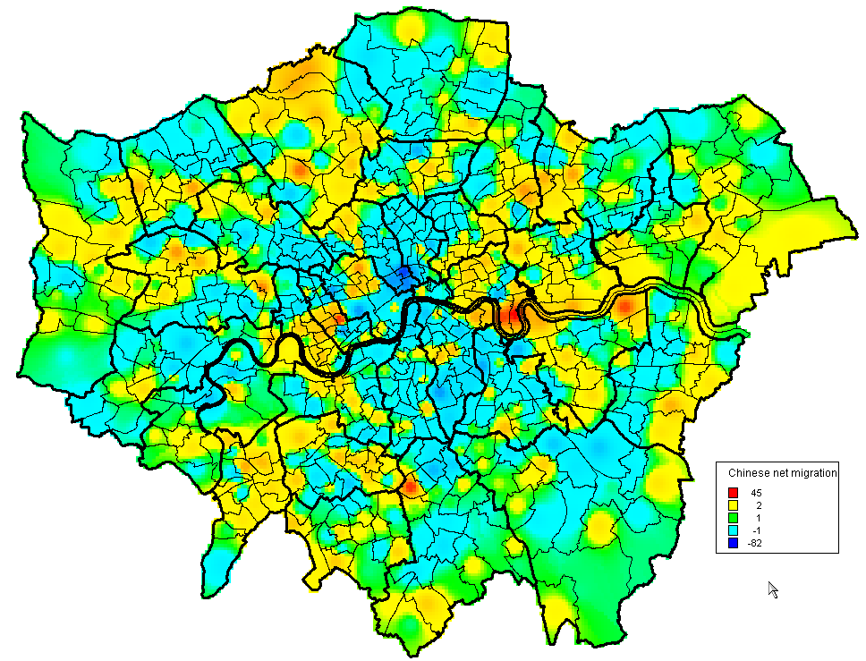
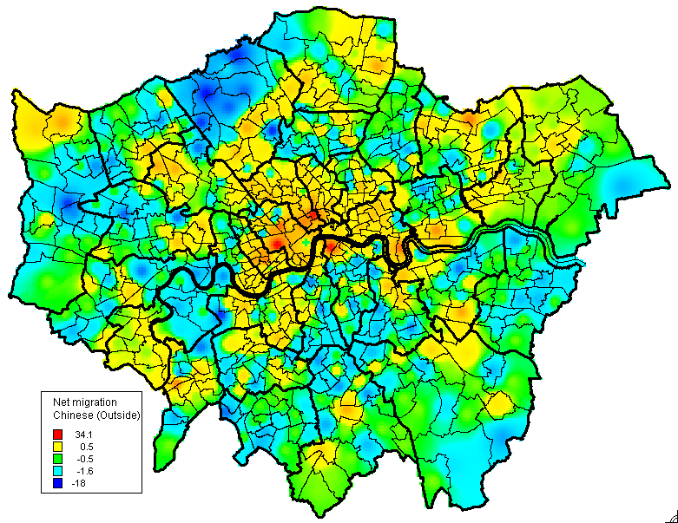
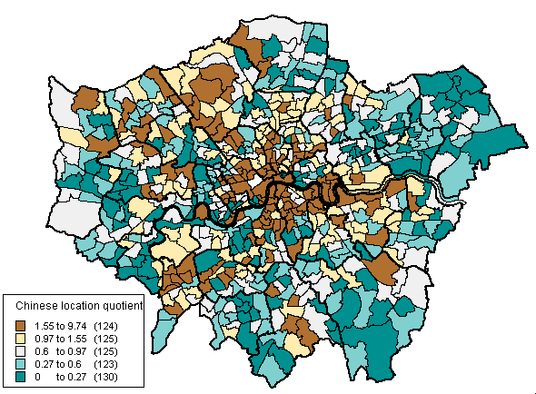
Are the same processes of migration apparent for Chinese migrants in London?
Net migration flows within Net migration flows between
Greater London London and rest of England and Wales
Source: 2001 Census Commissioned Table
Location quotients

Slide 28
Example 4: Comparison of PR/NHSCR and Census migration at district level, England and Wales, 2000-01
IN
r = 0.985
NET
OUT
r = 0.987
r = 0.783

Slide 29
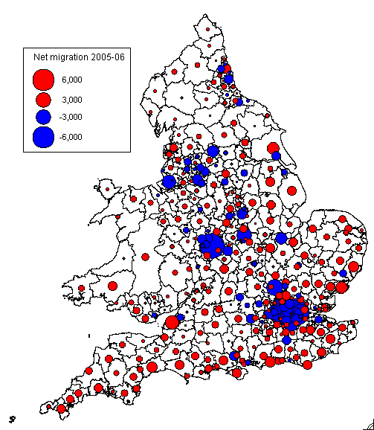
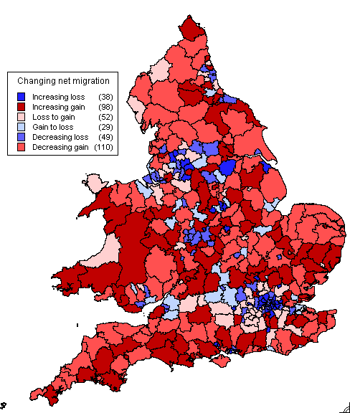
Changing patterns of net migration as shown by patient registration/NHSCR data
2005-06 balances
Changes in net balances
2000/01-2005/06

Slide 30
3. What potential does the 2011 Census provide for data provision and research?
3.1 What has not changed since 2001 in terms of available data based on questions asked?
3.2 What about statistical disclosure control?
3.3 What new questions enable further ‘interaction’ data to be generated?

Slide 31
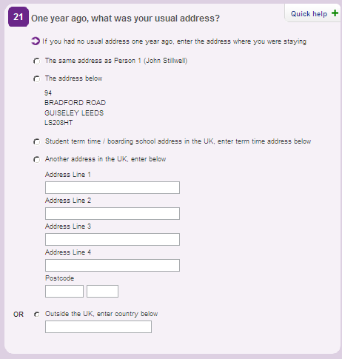
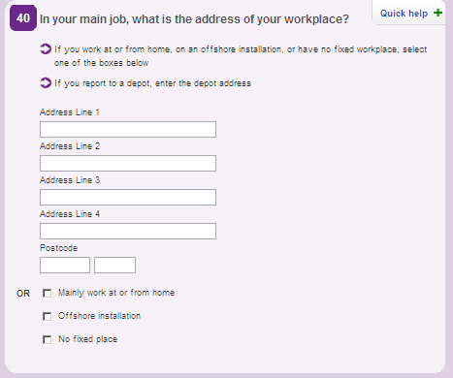
3.1 Questions in 2011 are the same as in 2001 for migration and commuting

Slide 32
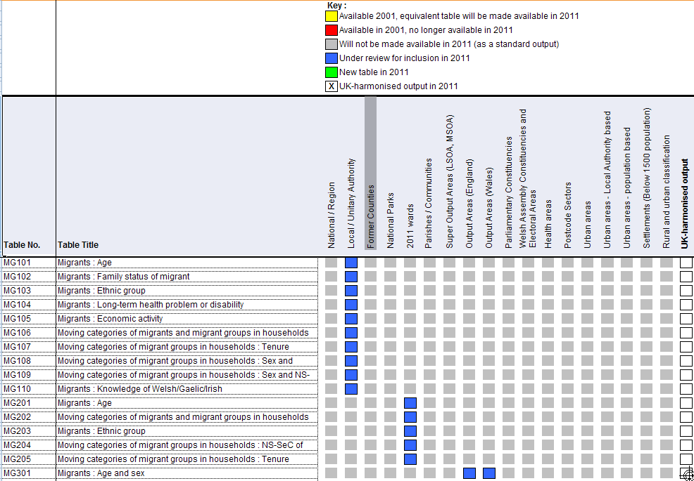
Migration tables in SMS still under review but look as though they are going to be the same
Source: ONS (2011) Proposed geographies for tables, http://www.ons.gov.uk/census/2011-census/consultations/open-consultations/2011-output-consultation---main-statistical-outputs---second-round/index.html

Slide 33
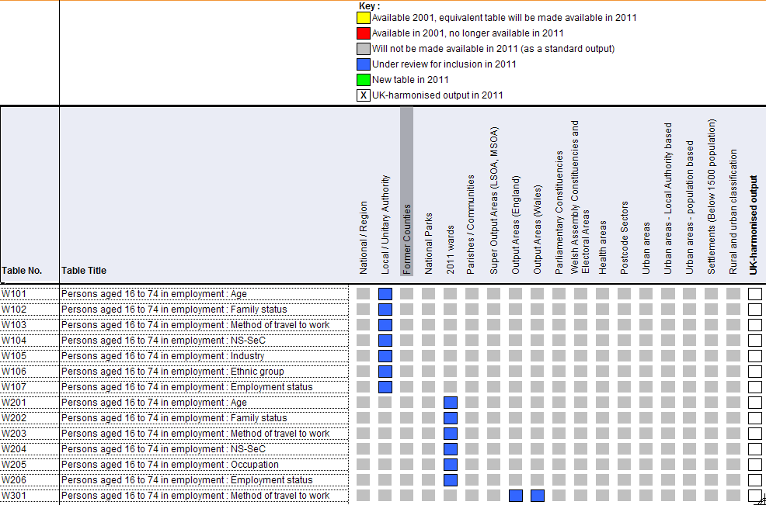
Same with commuting tables SWS/STS
Source: ONS (2011) Proposed geographies for tables, http://www.ons.gov.uk/census/2011-census/consultations/open-consultations/2011-output-consultation---main-statistical-outputs---second-round/index.html

Slide 34
New geography of commuting destinations: Workplace Zones (WPZs)
OAs based on where people live not work – can be unsuitable for workplace statistics
Some OAs contain no/few businesses; some contain many businesses or large employer, e.g. business parks, City of London
Workplace Zones project looking at splitting/merging OAs for a new geography constrained to MSOAs
Pilot areas: Tower Hamlets, City of London, Southampton, Nottingham, Suffolk Coastal
Disclosure control: Population threshold same as OAs (100 workers min; 625 max; no household threshold)
Source: Spicer, K. (2011) Statistical Disclosure Control for 2011 UK Census, http://www.ons.gov.uk/census/2011-census/consultations/open-consultations/2011-output-consultation---main-statistical-outputs---second-round/index.html

Slide 35
3.2 What about statistical disclosure control?
Small cell adjustment abandoned in favour of record swapping:
- Households swapped
- Targeted to ‘risky’ records
- Construct risk score for every individual; combine to household score
- Imputation considered as part protection
- Households swapped only as far as their risk is considered ‘high’
- Individuals swapped between communal establishments
Work on SDC on Origin-Destination Tables still ongoing
Source: Spicer, K. (2011) Statistical Disclosure Control for 2011 UK Census, http://www.ons.gov.uk/census/2011-census/consultations/open-consultations/2011-output-consultation---main-statistical-outputs---second-round/index.html

Slide 36
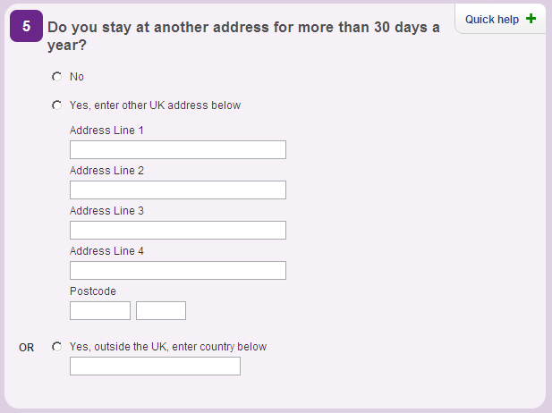
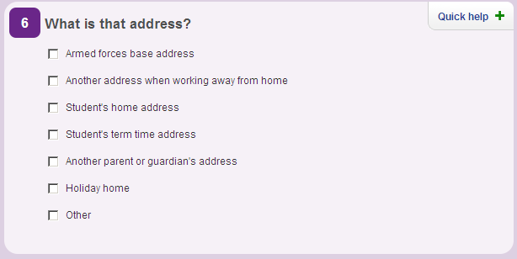
3.3 What new questions enable further ‘interaction’ data to be generated?
Questions 5 and 6 ask about another address
Potential to produce matrices of interaction flows between usual address and other address – very useful for analyses of mobility (weekly commuting, shared custody of children, second homes, international mobility) hitherto uncaptured …… except for students

Slide 37
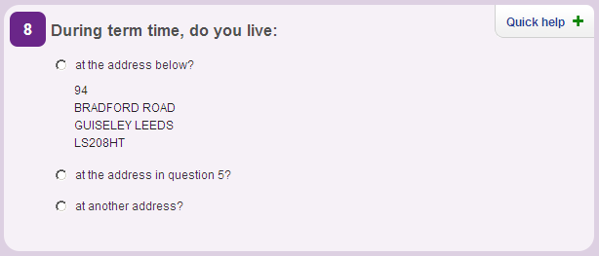
Student ‘migration’ picked up by separate questions

Slide 38
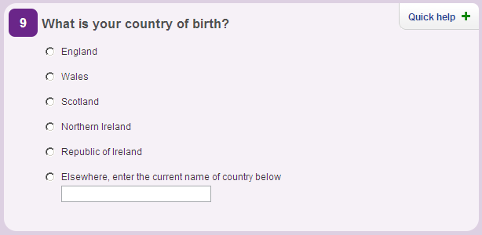
Questions about international immigration

Slide 39
4. Conclusions: How will CIDER develop in the future?
Anticipation of substantial demand for access to 2011 Census interaction data sets
Continue to offer user access to data from previous censuses
Recognise the ‘new’ environment – with 2011 Census being the last census of its kind
Focus data from on surveys and administrative sources
ONS ‘Beyond 2011’ project and Integrated Population Statistics System
WICID will incorporate various non-census data sets and use same type of query interface for extraction and downloading

Slide 40
WICID will become a repository for all types of interaction data
CIDER already collecting other non-census data sets on:
(i) internal migration (e.g. NHS patient movement data time series from 1988-89 to 2008-09; HESA student flows)
(ii) international data (e.g. from a series of different administrative sources including GP Flag 4 registrations; NINo registrations; HESA statistics – all at district level)

Slide 41
Some challenges for WICID
Re-design the interface (and metadata) to present better classification of data sets
List by source as well as by theme
Extending the interface to handle time-series data
Easy selection of multiple waves of data of interest
Time series analysis and summary functions
Extend the range of supported geographies
Different types of geography (point locations as well as area)
Clearly display of relevant geographies
Incorporation of ‘on-the-fly’ disclosure control routines for datasets like HESA
Round data after aggregation but before giving to user
Improved mapping of results
Flow maps of extracted data
Choropleth maps of extracted data and analysis results

Slide 42
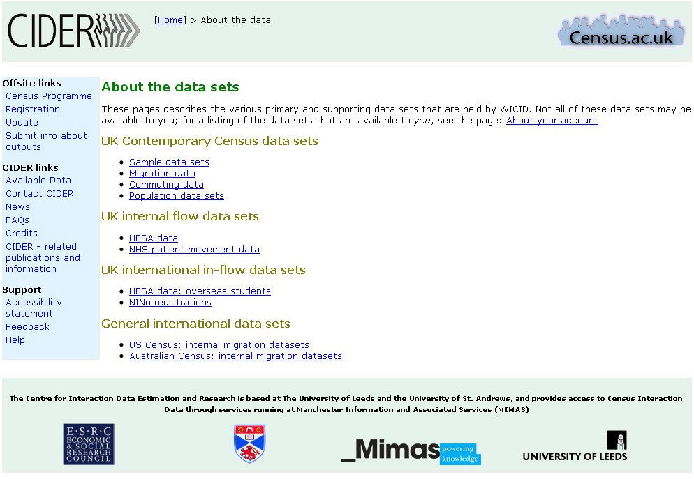
Improved data divisions

Slide 43
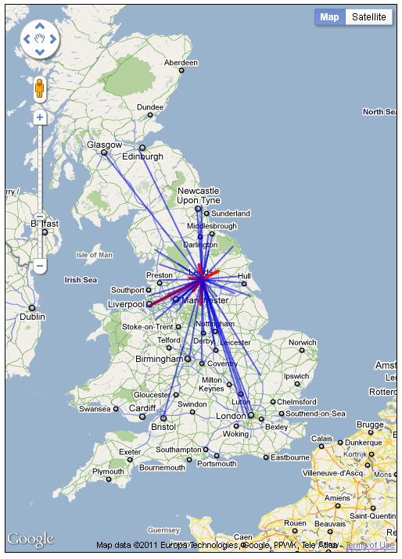

Slide 44
Changing access arrangements
Access arrangements for 2011 Census data are not yet known
ONS concerned about disclosure risks in interaction data
There may need to be a more secure path for spatially detailed data
However, interaction data don’t necessarily fit the current security models
Open Government Data models suggest easier access to data, not harder access

Slide 45
The benefits of an API based system
Delivery of data via an API offers close linking of values with their corresponding metadata
This should make it easier to match data items with the right populations when calculating rates
Makes it easier to add new specialised aggregations as they become available
Easier to re-purpose ONS data
Allow WICID to become a value-adding conduit for data

Slide 46
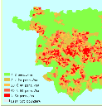
WICID application
WICID RESTful API?
ONS Read API
system
ONS 2011 data repository
?
ONS 2001 data
Legacy Census data
(CIDER)
Other data sources
ONS pre-2001 data

Slide 47
ONS web environment

